Slide 1


Copper Processing

Slide 2
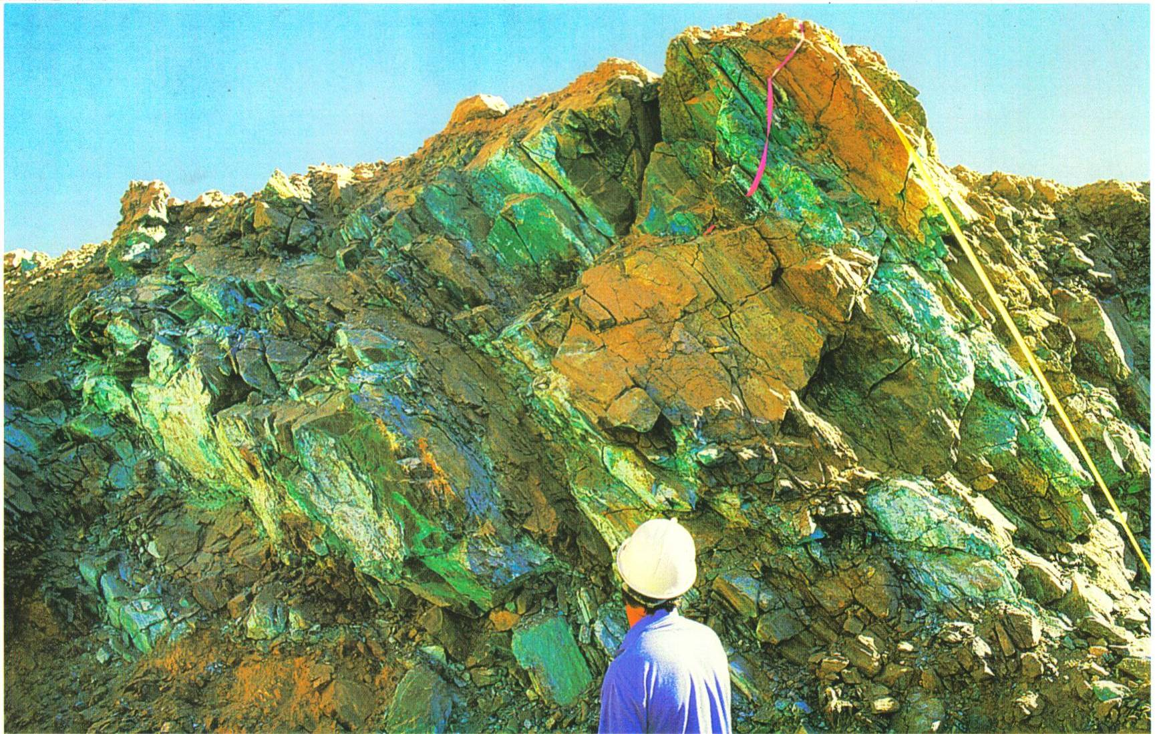
Copper
Notes:
Image Description:
Rich deposit of copper ore
Teaching Tip: Background: Copper is a valuable mineral and metal especially useful in the delivery of electricity and water. It has a number of properties:
Copper is deep pink-brown and is the only metal other than gold, to have a distinctive colour.
Copper is an excellent conductor of heat and electricity (second only to silver).
Copper is soft but tough.
Copper is quite rare.
Copper is malleable and ductile (can be beaten and drawn into a wire)
Copper has the symbol Cu (from the Roman word Cuprum - their word for the island of Cyprus, famous for its copper mines).
Copper can be alloyed (mixed) with many other metals.
Source: rock files http://www.australianminesatlas.gov.au/education/rock_files/copper.jsp

Slide 3
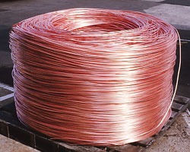
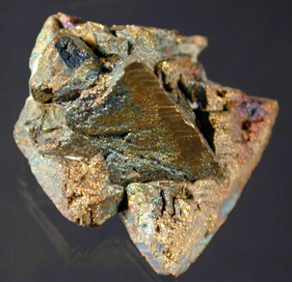
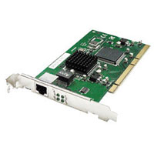
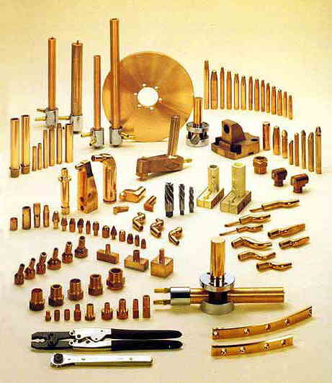

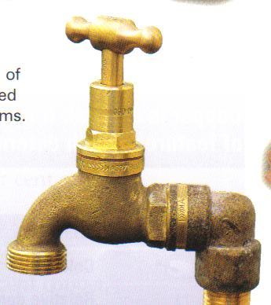
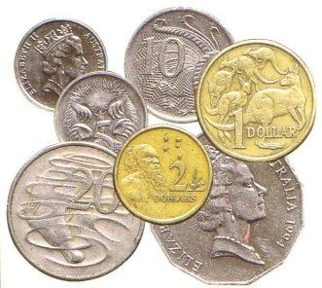
Copper and its Uses
Notes:
Image Description:
Uses of copper
Teaching Tip: Background: Copper uses
Electricity and Communication
As copper is ductile and a great conductor, its main use is in electric generators, household/car electrical wiring, and the wires in appliances, computers, lights, motors, telephone cables, radios and TV sets.
Coins
The alloy 'cupronickel', a mixture of 75% copper and 25% nickel, is used for making 'silver' coins such as our 5, 10, 20 and 50 cent pieces. Our $1 and $2 coins are 92% copper, mixed with aluminium and nickel.
Pipes
As copper does not rust easily, and can be easily joined, it is useful for making water pipes (and hydraulic systems). The use of copper in water pipes dates back to the ancient Egyptians and Romans.
Heat Conducting
Copper's ability to conduct heat means it is used for car radiators, air conditioners, home heating systems, and boilers to produce steam. It is also ideal for the base of cooking pots.
Fungicides and Insecticides
Copper sulphate is used to kill algal blooms in water reservoirs, to protect timber, to stop plant roots from blocking rains and sewerage systems, and to kill insects.
Fertilisers
Copper production was boosted in the 1950s and 1960s by the need for copper-based fertilisers to aid crop growth in previously unproductive land.
Bronze
Bronze (90% copper, 10% tin) is used for statues, and bearings in car engines and heavy machinery.
Brass
Brass (70% copper, 30% zinc) is particularly rust-resistant and so is used to make the hulls of sailing boats and other marine hardware. Many musical instruments are made from brass. Also decorative pieces, from light fittings to taps, and instruments for astronomy, surveying, navigation and other scientific purposes.
Source: http://www.australianminesatlas.gov.au/education/rock_files/copper.jsp

Slide 4
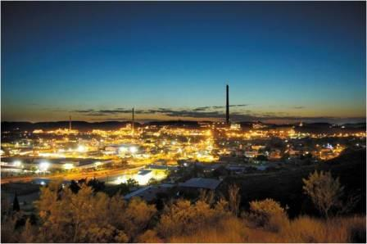
Underground Mining
Mt Isa Mine Mt Isa Queensland image courtesy of Xstrata Copper
Notes:
Image Description:
Mt Isa image courtesy of Xstrata Copper
Teaching Tip: Background: Copper can be mined by both underground and open-cut mining methods.
Mt Isa is a major Australian mining town located in the north west of Queensland where copper, lead and zinc is mined in mainly underground mine operations.

Slide 5
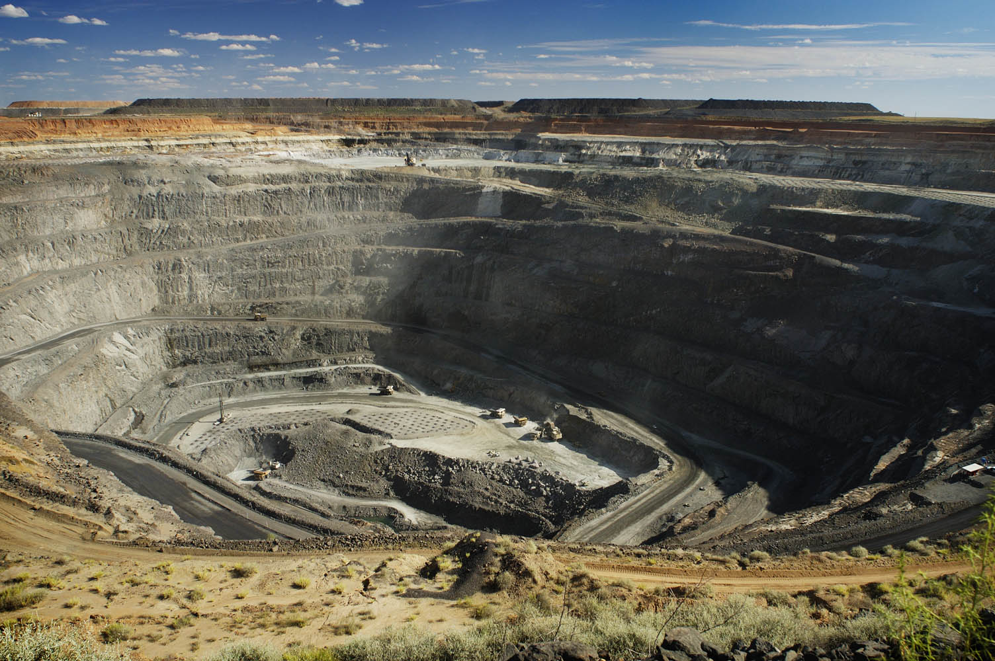
Open-cut Copper Mining
Open-cut pit – the rock is drilled and blasted then removed by a truck and shovel operation. The ore is processed to separate the copper.
Ernest Henry Mine Cloncurry Queensland image courtesy of Xstrata Copper
Notes:
Image Description:
Ernest Henry Mine Cloncurry Queensland image courtesy of Xstrata Copper
Teaching Tip: For more background on open-cut mining see fact sheet on www.oresomeresources.com

Slide 6
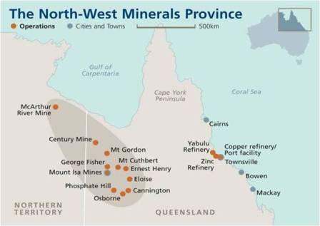
Location of Copper Mines
Image courtesy of Xstrata Copper
Notes:
Image Description:
Map of north west Queensland
Teaching Tip:
Encourage students to think about where copper is located in relation to major towns and ports and the challenges faced in discovering the deposits and difficulties in transporting the product out.
See Oresome Resources Google Map ‘Operating Queensland Mines’

Slide 7
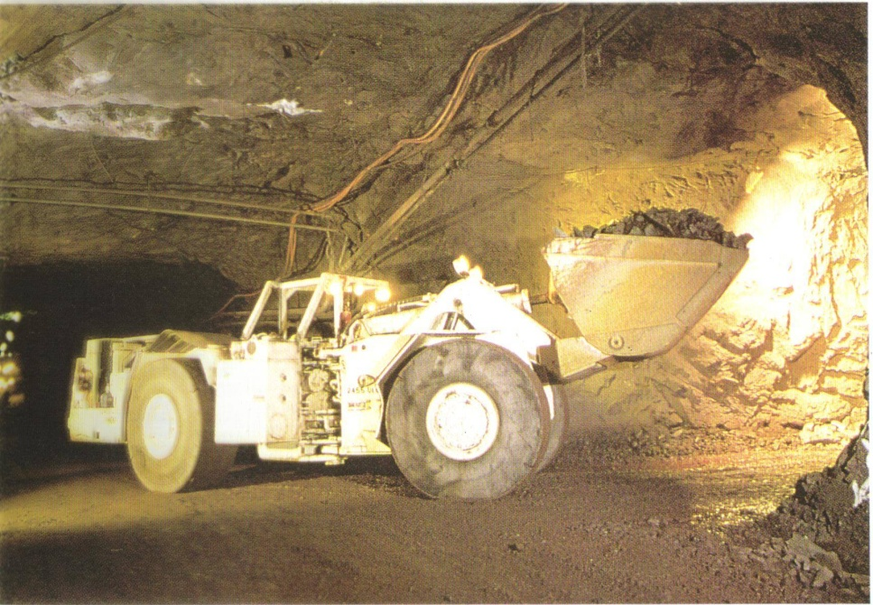
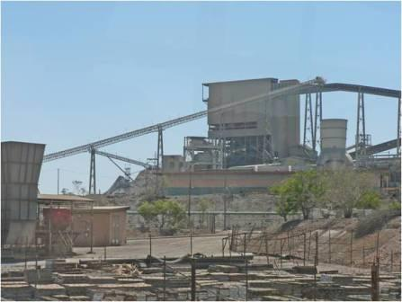
Underground Mining Process
Underground mining of copper occurs adjacent to the copper smelter in Mt Isa . In some cases remote controlled vehicles such as boggers are used underground.
Images courtesy of Xstrata Copper
Notes:
Image Description:
Remote controlled bogger and structure at Mt Isa
Teaching Tips:
Background: Underground the copper ore is drilled and charged with explosives which are detonated to break the ore from draw points at the bottom of the stope. The large chunks of copper ore are crushed in crushers, usually located underground, to a finer size usually about 150mm.
The ore is hauled in 35 t trucks to the surface using the decline system or placed in skips which are then raised to the surface.
The hazards/problems of mining could be discussed briefly here. Most students will be familiar with some of the problems of underground mining e.g.
underground mines can be very hot in excess of 60 degrees C. Significant cooling equipment is required to keep the underground mine at a comfortable working level

Slide 8
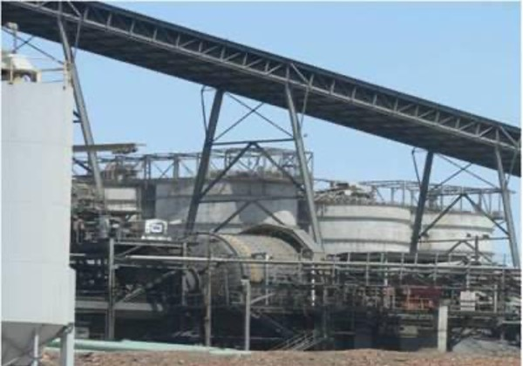
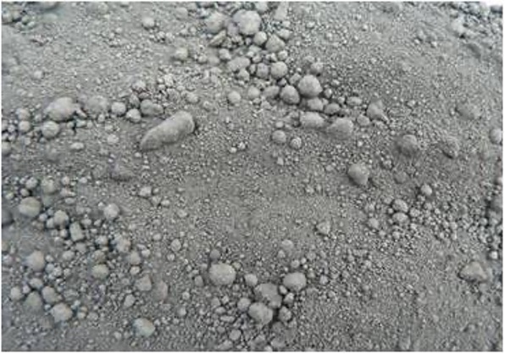
Mineral Separation
A ROD and BALL MILL contains the ore and heavy steel balls which break the rock up until it resembles a fine powder.
Images courtesy of Xstrata Copper
Notes:
Image Description:
Milling
To release the mineral from the ore, the crushed ore is further reduced in size by a grinding action in revolving mills that contain steel rods and balls.
The material most closely resembles black talc.

Slide 9
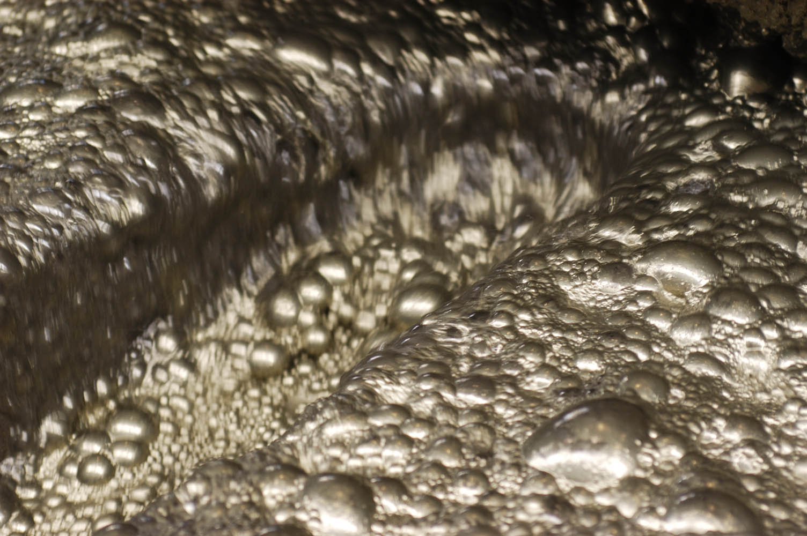
Concentrating Flotation
Image source: Queensland Resources Council
Notes:
Image Description:
Flotation tanks
Teaching Tip: Background:
The ground ore is fed into flotation tanks. In froth flotation, quite a complex process takes place with a type of detergent (frother) and other additives being tailor made to suit the mineral being extracted and the particular ore body. The valuable mineral clings to air bubbles introduced at the bottom of the flotation cells. The copper concentrate floats away and is recovered. This along with the remainder of the processes that are described are the work of metallurgists – people with an interest in chemistry, earth science and engineering. This process increases the concentration of copper from 3% to about 15%.

Slide 10
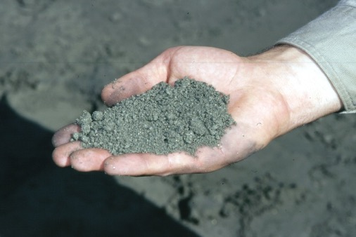
Froth Flotation Process
Crushed ore is mixed with water, detergents and other chemicals
Finely powdered mineral clings to air bubbles and floats to the surface
Waste rock sinks to the bottom
Copper concentrate is transported to the thickeners to remove excess water
Dried concentrate is transported to the stacker for storage before use
Waste rock is returned to the site
Water is re-used (as much as possible).
Image source: Queensland Resources Council

Slide 11
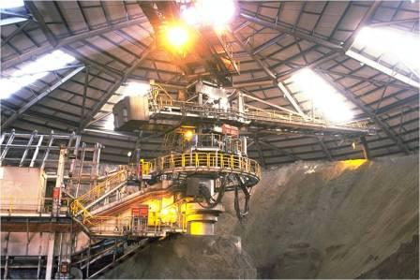
Stacker Reclaimer
Image courtesy of Xstrata Copper
Notes:
Image Description:
Stacker reclaimer
Teaching Tip: Background: This is a large storage facility for the concentrated ore – the percentage of copper has now increased from 3%(approx) to about 15%. The smelter at Mt Isa uses material from the Mt Isa mine and from Ernest Henry mine. These two mines make a very different product. Also the product from different parts of each mine varies. To even out these differences as much as possible they are carefully layered in the stacker and material is removed in a specific pattern. The building is roofed so that material does not blow away or is washed away in heavy rain. The stacker/reclaimer also creates a buffer against any production problems – there is always product available for the furnace.

Slide 12
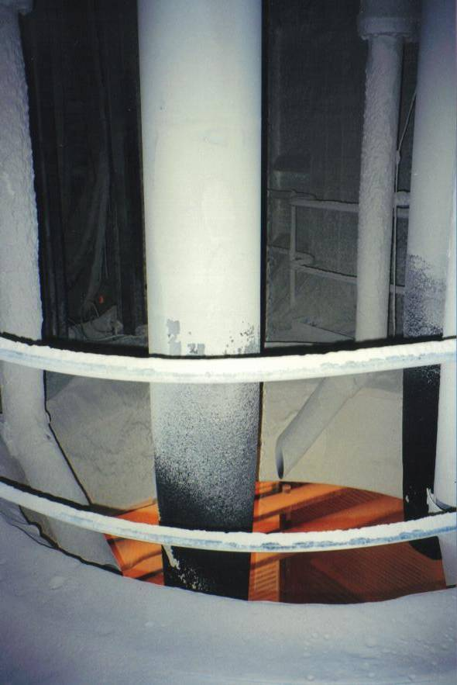
Isasmelt
Image courtesy of Xstrata Copper
Notes:
Image Description:
Xstrata Copper Isasmelt
See next slides for more information

Slide 13
Smelting
The process of taking the copper concentrate(CuFeS₂) and reacting it with SiO_{2,} and O₂ to produce slag (waste), copper matte and sulphur dioxide (gas).
The SO₂ is collected at several stages and is used to make sulphuric acid which is further processed into fertiliser.
The matte copper is further treated in a copper converter.
Notes:
Image Description:
Teaching Tip: This is the overall process.SiO2 = silica (basically sand) except here it is found in the rocks that are being mined and is deliberately added to the concentrate to keep the silica ratio correct.

Slide 14
Smelting
Off Gases
(CO₂,SO₂,H₂O,N₂)
Oxygen (O₂)
Air (N₂,O2)
Natural Gas (C,H)
Concentrates (CuFeS₂)
Flux (SiO₂)
Coal (C,H)
Isasmelt Lance
10CuFeS₂ + 15½O₂ + 3½SiO₂ ⇒
5Cu₂S + 3FeS (matte)
+ 3½Fe₂SiO₄ (slag)
+ 12SO₂ (gas)
Isasmelt Furnace
Rotary Holding Furnace
Diagram courtesy of Xstrata Copper
Notes:
Image Description:
1. The furnace is where the first of the reactions takes place. The bricks are chrome magnesium bricks and the roof is made of water cooled copper blocks.
2. The lance allows these gases to be introduced into the mixture
3. These are the products that are fed into the reaction – the Concentrates from the stacker/reclaimer, additional silica called flux and coal as a carbon source.
4. The additional O2 is added so that the reaction can take place. Natural Gas is taking the place of coal as the carbon source.
5. These are the gaseous products of the reaction. SO2 is the product with the potential to do the most damage as it converts to sulphuric acid in the atmosphere. These days these gases are trapped and used to make fertiliser.
6. This is the overall reaction for this stage. Iron/Silica material is called slag and is a waste material. Matte is the form the copper is now in. In reality the slag still contains copper and is reused to control the temperature of the reaction. Other copper containing waste from around the site is also fed back into the process.

Slide 15
Silicia Ratios
The correct amount of flux (SiO2) must be added or an efficient reaction does not occur.
Too little silica results in the formation of magnetite (an iron oxide).
Magnetite has a much higher melting point and can form a layer on top of the smelter causing damage to the smelter. It can also clog the vents from which the molten material is removed. Some magnetite is always made and it sticks to the walls of the smelter. This helps to protect the bricks.
Too much silica makes the mixture too sticky.

Slide 16
Converting
Flux (SiO₂)
Off Gases (SO₂)
Pierce Smith Converter
Matte (Cu₂S FeS)
Air (N₂,O₂)
Oxygen (O₂)
Slag Blow
2FeS + 3O₂ + SiO₂ ⇒
Fe₂SiO₄ (slag)
+ 2SO₂ (gas)
Copper Blow
Cu₂S + O₂ ⇒ 2Cu (blister)
+ SO₂ (gas)
Slag
Blister Copper
Notes:
Image Description:
Teaching Tip: Background: Molten copper matte is transferred by cast steel ladles to the converters where silica is added causing an iron slag to form. Sulphur is removed as an off gas and the slag is also removed from the matte.

Slide 17
Converting
Blister (Cu, Trace S, Trace O)
Blister Copper
Off Gases (SO₂, CO_{2,} N₂)
Casting
Anode Furnace
Air (N₂,O₂)
Natural Gas (C,H)
Anode Copper
Oxidising
S + O₂ ⇒ SO₂
Reducing
1½O₂ + C + H ⇒ CO₂+ H₂O
Notes:
Image Description:
Further converter treatment produces blister copper.

Slide 18
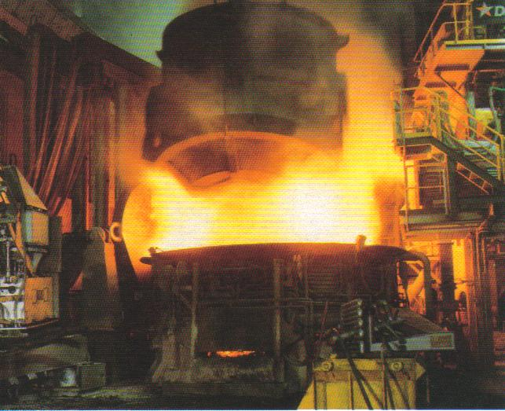
Slag Pouring
Image courtesy of Xstrata Copper
Notes:
Image Description:
The slag from the smelter can contain about 20% copper. It is allowed to cool then treated by grinding and flotation to recover additional copper

Slide 19
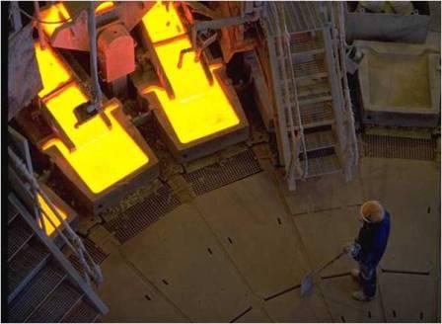
Anode Casting
Image courtesy of Xstrata Copper
Notes:
Image Description:
Anode Casting
Teaching Tip: Blister copper is heated in an anode furnace to remove further impurities. The copper is then cast in shapes called anodes, which can be railed to a refinery for final purification.

Slide 20
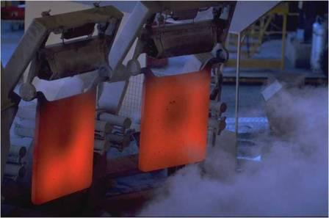
Anodes prior to quenching
Image courtesy of Xstrata Copper

Slide 21
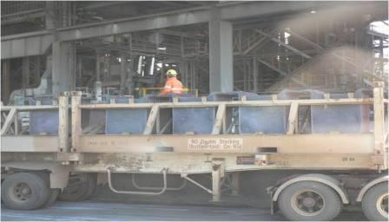
Anode Transport
Image courtesy of Xstrata Copper

Slide 22
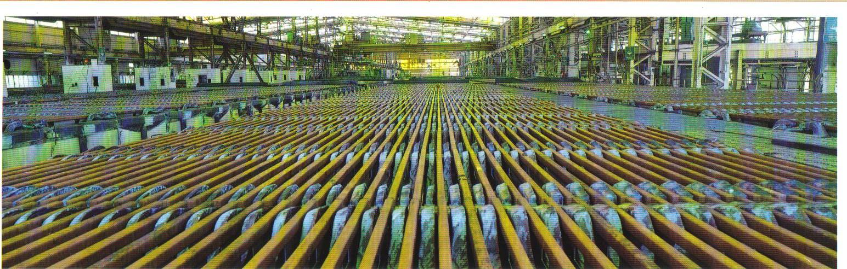
Copper Refining
Notes:
Image Description:
Refining tanks Xstrata Copper Refinery Townsville
Teaching Tip: Background: A copper anode is slotted in with stainless steel (cathode) plates between them. An electric current is passed through and copper grows on the stainless steel plates. An anode last for three weeks and the S/S boards are stripped weekly.

Slide 23
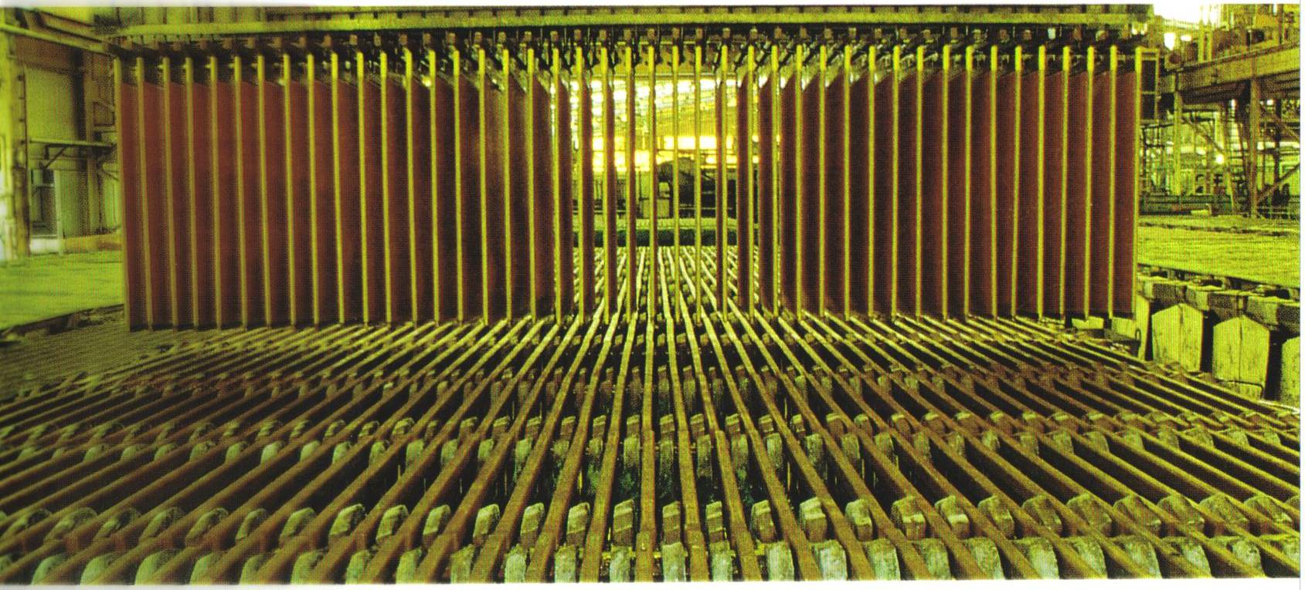
Copper Refining
Notes:
Image Description:
Copper anodes are being lowered into tanks

Slide 24
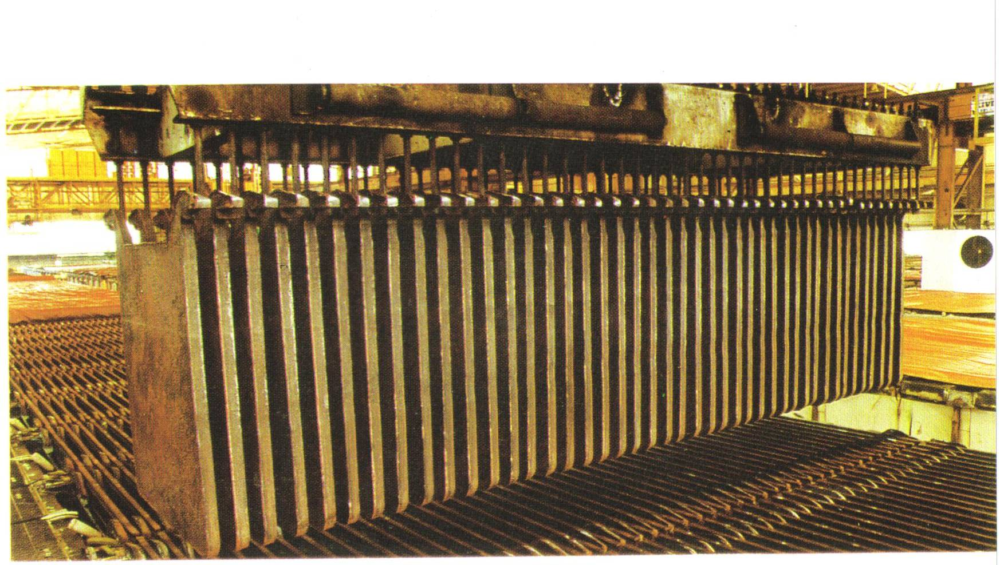
Copper Refining
Notes:
Image Description
Stainless steel plates coated in copper are removed from the tanks

Slide 25
Credits
Queensland Resources Council wishes to acknowledge Xstrata Copper for the provision of these images and teacher Alison Pound ,Wavell State High School for her input into this presentation.

