Slide 1


Energy – Renewable and non-renewable sources

Slide 2
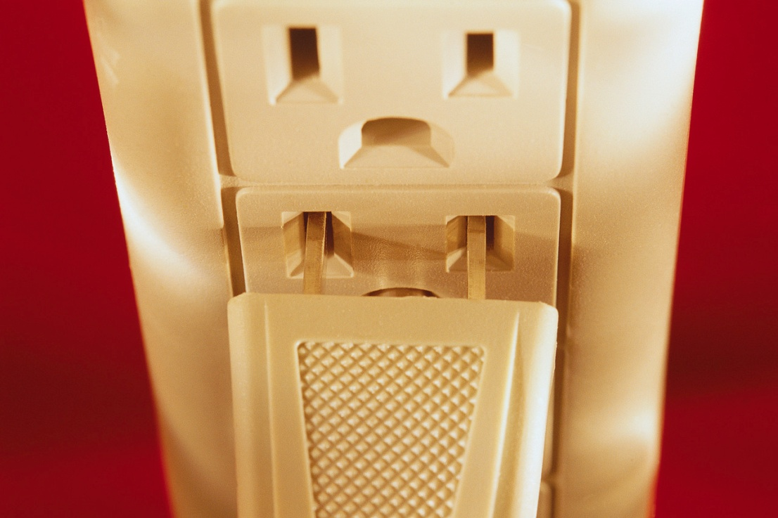
Forms of Energy
How have you used energy this morning?
walking
running
turning on the light…
Notes:
Image Description:
Powerpoint
Teaching Tips:
Ask students :How have you used energy this morning? Walking, running, playing, turning on the light, turning on the toaster…
Discuss the fact there are many forms of energy, but this is a focus on electrical energy and the provision of power.

Slide 3

Challenges
What challenges face the world today?
Notes:
Image Description:
Solar panels
Teacher Tips: Ask ‘What is renewable energy?’ ‘What are some examples?’
Background notes:
Renewable energy refers to:
Sources of energy that are continually being renewed
Energy that is unlikely to run out.
Energy types that include solar energy, hydropower, wind, waves and tides.

Slide 4
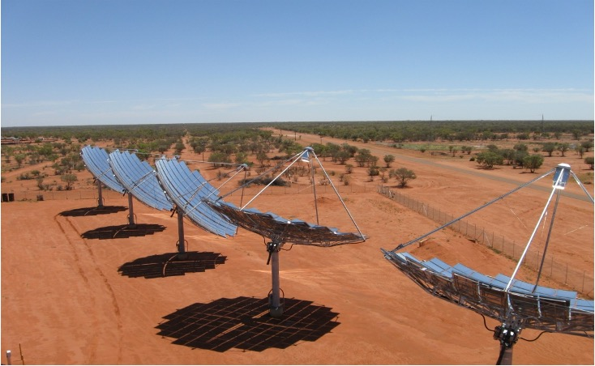
Renewable Energy
Definition:
Source of energy that will not run out
Examples:
Solar
Wind
Wave
Courtesy of Ergon Energy
Notes:
Image Description:
Solar panels
Teacher Tips: Ask ‘What is renewable energy?’ ‘What are some examples?’
Background notes:
Renewable energy refers to:
Sources of energy that are continually being renewed
Energy that is unlikely to run out.
Energy types that include solar energy, hydropower, wind, waves and tides.

Slide 5
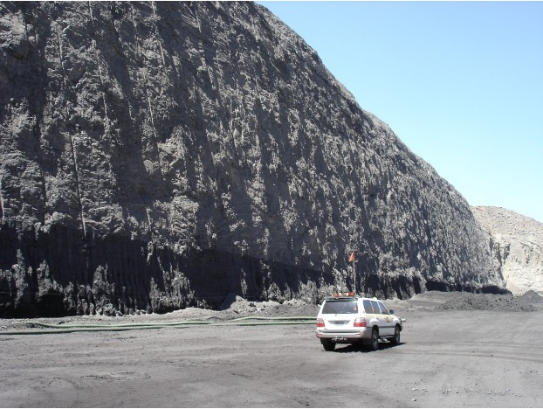
Non-renewable
What are examples of non-renewable energy?
Coal
Petrol
Natural Gas
Fossil Fuels
Courtesy of Queensland Resources Council
Notes:
Image description:
Coal seam central Queensland
Teacher Tips: Ask: What is non-renewable energy?
Background notes:
A non-renewable resource is:
A natural resource, such as coal, natural gas and crude oil
A resource which takes thousands or millions of years to form naturally and cannot be replaced once it has been used
A resource which has high carbon content because it was formed from the buried remains of plants and animals that lived millions of years ago. The fuels, once combusted then release this carbon back into the atmosphere as carbon dioxide.

Slide 6
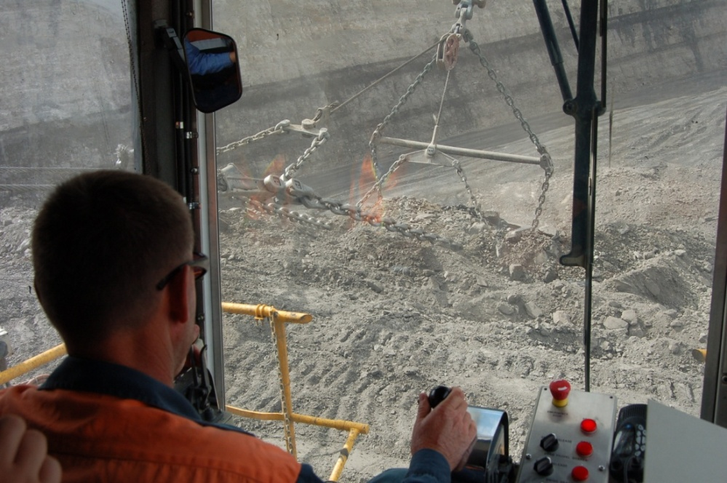
Advantages
Coal provides:
income from exports
direct and indirect employment
royalties to government used in essential services including schools, hospitals, roads and police
source of cheap, reliable, electricity.
Courtesy of Queensland Resources Council
Notes:
Image Description: Dragline operator central Queensland coal mine
Teacher Tip: Brain storm other economic advantages of coal
Value in income from exports
direct and indirect employment
royalties to government used in essential services including schools, hospitals, roads and police
source of cheap , reliable, electricity

Slide 7
Disadvantages
Use of a non-renewable resource
Creates environmental impacts when mining
On combustion, emits air pollutants such as carbon dioxide, and nitrogen oxides,
Creates waste in the form of ash which needs to be stored
Uses large amounts of water in the electricity generation process.
¹ Source: Australian Coal Services
Notes:
Teacher Tip: Brain storm what the disadvantages of coal could be

Slide 8
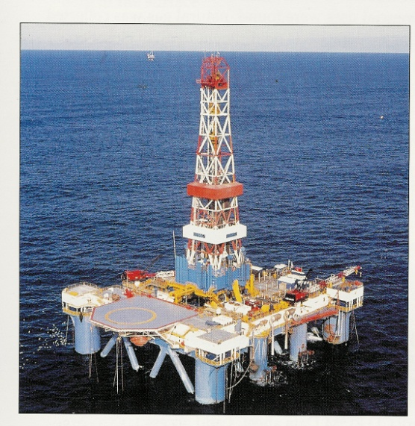
Advantages
Is easily combustible
Has a high heating value
Is able to be transported easily
Notes:
Teaching Tip: Background Notes:
Easily combustible, and produces high energy upon combustion helping in the generation of electricity and various other forms of energy
Widely and easily distributed all over the world through rail and sea tankers
Comparatively inexpensive due to large reserves and easy accessibility
Reasonable availability ; although becoming more difficult to find
Large amounts of electricity can be generated in one place using oil
Oil-fired power stations are very efficient
An oil-fuelled power station can be built almost anywhere, so long as you can get large quantities of fuel to it.
Source: http://wiki.answers.com/Q/What_are_the_advantages_and_disadvantages_of_oil_as_an_energy_source

Slide 9
Disadvantages
Is a non-renewable resource
Combustion of oil produces greenhouse gases
Sources of oil are becoming more difficult to find
Cost of oil can be high (relative to demand)
Notes:
Teaching Tip: Background Notes:
It is non-renewable and fast depleting
Burning it releases carbon dioxide, a greenhouse gas, that had been stored in the earth for millions of years
Mining oil can impact on the environment; sea and land
Oil spills can occur from oil rigs and tankers
The cost of oil is driven by supply and demand.

Slide 10
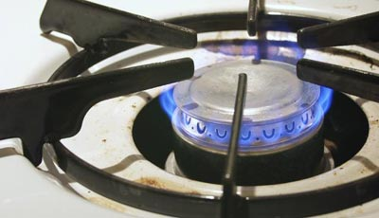
Advantages
Produces half the greenhouse gas emissions of coal and oil
Has a high heating value
Is accessible from a number of areas
Can be transported easily by pipes to homes and businesses
Can be used as a source of hydrogen energy
Image courtesy of Western Power
Notes:
Image Description: Gas burner
Teaching Tip: Background notes:
Natural gas plays a major role in the Australian and global energy market. It is a non-renewable energy resource as its supplies are limited and cannot be replaced easily in the foreseeable future. It has been estimated by the Commonwealth Scientific and Industrial Research Organisation (CSIRO) that there is around one hundred years of natural gas reserves in Australia.

Slide 11
Disadvantages
Is a non-renewable resource
On combustion produces greenhouse gases; mainly carbon dioxide
Costs involved in exploration, infrastructure e.g. plants and pipelines
Notes:
Teaching Tip: Background Notes:
The burning of natural gas to generate electricity does release greenhouse gases. These are fewer greenhouse gas emissions than the burning of coal or diesel oil. Gas structures around the world contain widely varying proportions of carbon dioxide (CO2). It is estimated that the burning of natural gas emits around 30 to 50 per cent less carbon dioxide than coal and oil, as well as less sulphur dioxide.

Slide 12
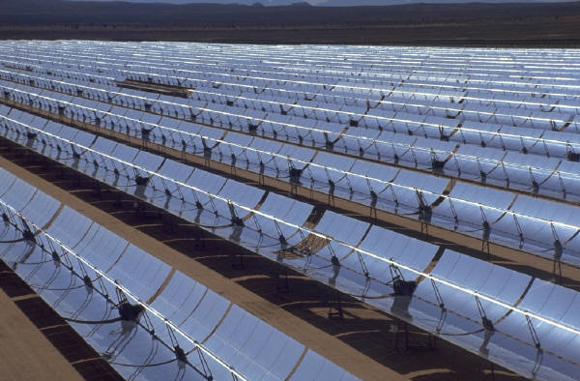
Solar Energy
Solar energy can be:
Direct solar heating
Photo-voltaic
Thermal electric
Notes:
Image Description:
Teacher Tip: Background notes:
Solar Thermal
The sun’s heat energy can be captured by a number of different collectors and turned into hot water. This type of power is called solar thermal.
Flat plate collectors are the most common form of solar thermal power used for instance in home hot water systems. These flat plate collectors are like greenhouses that trap and use the sun’s heat to raise the temperature of water up to about 70 degrees Celsius.
Because dark colours absorb more heat than light colours, the collector surfaces are usually painted black to absorb as much heat from the sun as possible. This helps water circulating through the panel to reach a higher temperature. Some collectors have a special surface, which reduces the amount of heat re-radiated from the collector. These produce even hotter water.
Parabolic dishes are concave-­shaped discs, which remain con­stantly focused on the sun with the aid of sun-tracking devices. The curve of each dish concentrates the sun's rays to a small central point, thus reducing heat losses and enabling water (or other fluid) passing through that point to be heated to a high temperature. If the temperature is high enough this water can be turned into steam to drive turbines to make electricity.
Photovoltaic Systems
Photovoltaic is another form of solar energy. A solar cell or photovoltaic (PV) cell is a ‘semiconductor’ device which is able to convert sunlight directly into electricity. The panels are made from special materials which produce a small electric current when exposed to light.

Slide 13
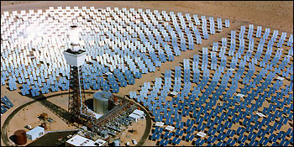
Advantages
Renewable
Limited CO2 emissions
The source of energy is free
Source: United States Department of Energy
Notes:
Image Description:
Solar 2 project in USA. This image is a work of a United States Department of Energy in the public domain wikipedia site http://en.wikipedia.org/wiki/Image:Solar_two.jpg
Teacher Tip: Brainstorm the advantages of solar energy.

Slide 14
Disadvantages
Not always sunny (not reliable)
Technology is expensive.
Cost of power is high
Equipment can be damaged in storms etc
Dust etc can impact on effectiveness

Slide 15
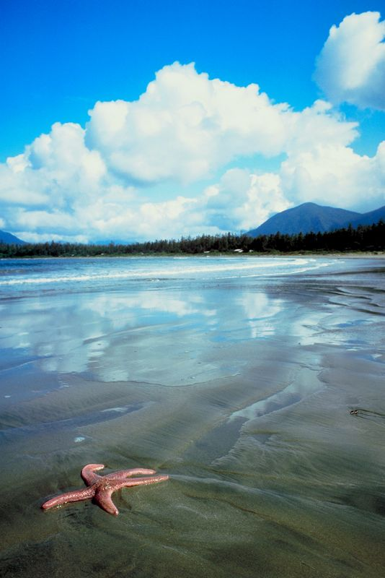
Tidal Energy
Who has noticed tidal movements?
Where?
How much?
Notes:
Description of image: Tides
Teacher Tip: Teacher prompt discussion based on students’ knowledge. Use a local context if one available e.g. Brisbane bayside students may be familiar with King Island at Wellington Point where one can walk to and from at low tide, but not high tide. Prompt similar discussion, especially any observations that tidal range is greater in some places than others.
Teacher notes:
Tides are caused by the gravitational pull of the Moon, and to a lesser extent the Sun, on the oceans around the world. The difference between high tide and low tide can be many metres, and the energy of the tidal movement can be used to generate electricity.
The water can be funneled to cause faster movement through turbines, and therefore produce more electricity.

Slide 16
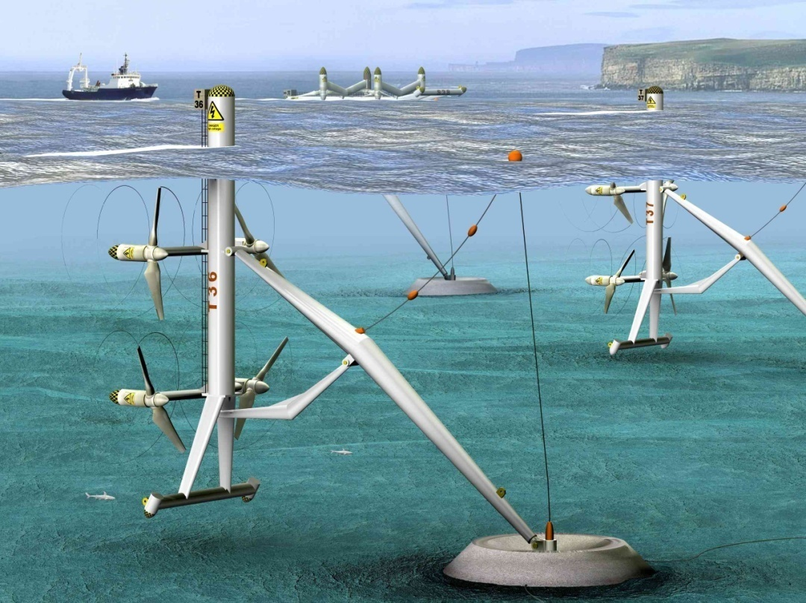
Tidal Energy
The tidal movement can pass through turbines to generate electricity.
Source: commons.wikimedia.org

Slide 17
Advantages
Renewable
Limited CO2 emissions; in construction of equipment
Notes:
Teaching Tip: Brainstorm advantages and disadvantages

Slide 18
Disadvantages
Can restrict shipping
Turbines can over heat
May impact on marine life and coastal ecosystems (mangroves)
Not all tidal ranges have a large enough range
Do not produce a lot of electricity
Barrages can change the flow of water and, consequently, the habitat for birds and other wildlife.

Slide 19
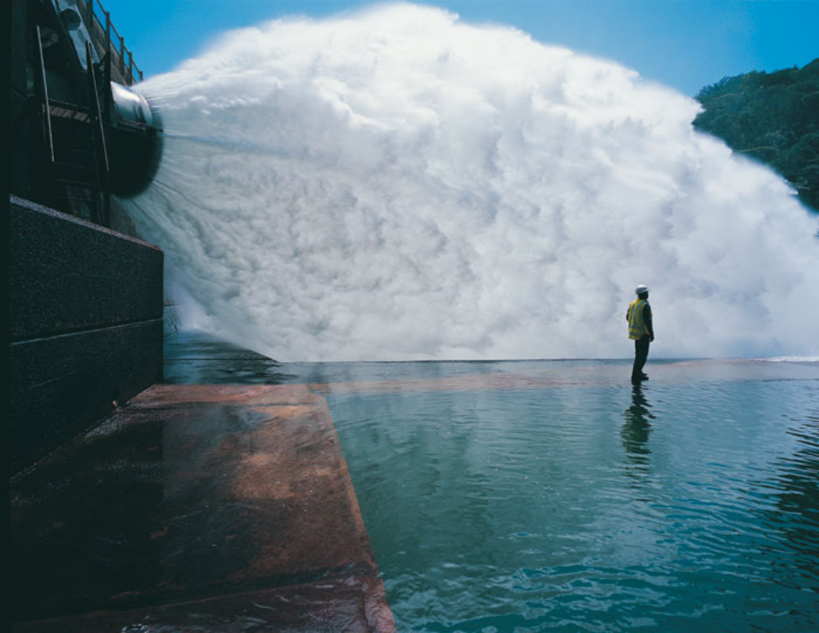
Hydro Electricity
Notes:
Image Description: Pipe at hydro electricity dam.
Teaching Tip: Brainstorm advantages and disadvantages of hydro electricity.
Background notes: If a dam is built across the river, water can be allowed to flow in a controlled way through turbines that generate electricity. Hydroelectric power schemes exist in many countries. They can be built in areas where there are fast-flowing rivers. These are often hilly or mountainous regions where rivers flow down steep slopes. On flatter land rivers flow more slowly, so large artificial dams are built to create reservoirs. The reservoir then provides a 'head' of water that can be directed through a turbine.

Slide 20
Advantages
Renewable form of energy
Limited CO2 emissions except in construction of equipment and if coal fired power is used to pump water back up to a higher dam
Notes:
Teaching Tip: Brainstorm advantages and disadvantages

Slide 21
Disadvantages
A suitable site is not always near where energy is being used
The building of large dams floods large areas and causes damage to existing habitats.
Changing the flow of a river can affect the water supply to other areas
Notes:
Teaching Tip: Discuss Impact of Snowy Mountain Hydro Electric Scheme on irrigators and health of river.

Slide 22
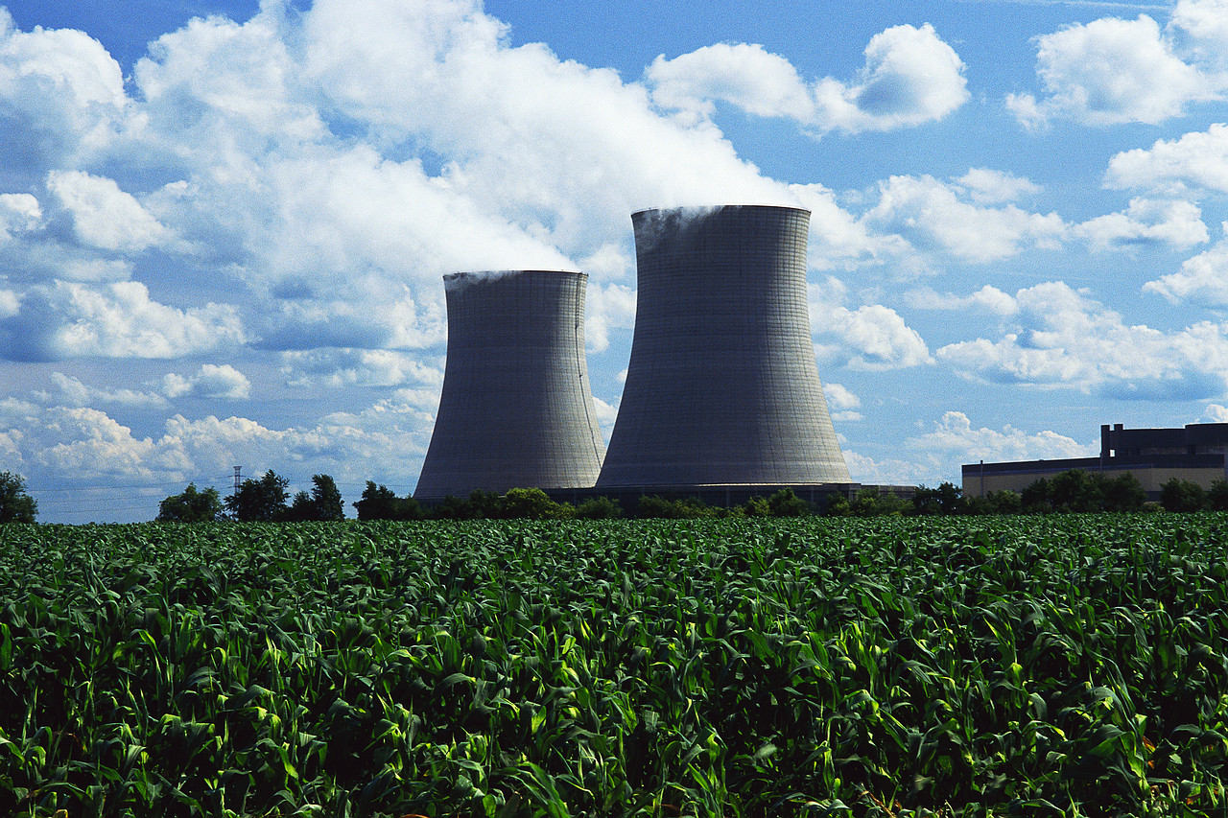
Nuclear
Splitting atoms to create energy.
Notes:
Image Description: Nuclear power plant
Teaching Tip: Background Teacher notes:
Splitting atoms to create energy
Nuclear power—derived primarily from the mineral uranium—currently produces 15 percent of the world's electricity, with 32 countries hosting approximately 435 nuclear power stations. http://www.uic.com.au/

Slide 23
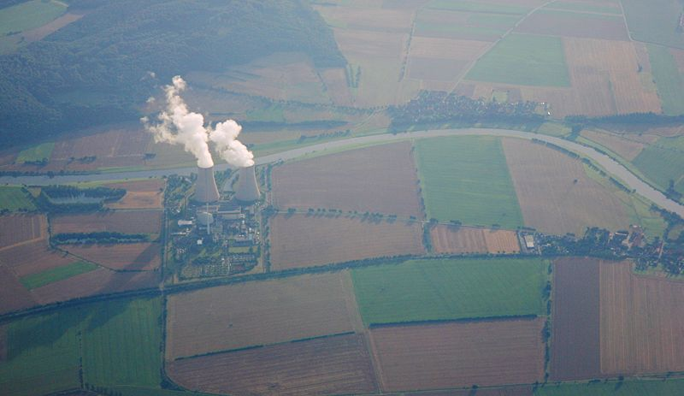
Nuclear
17% of world energy from uranium
437 nuclear power plants in operation world wide
70% France’s energy nuclear
Australia provides 30% world’s uranium
Notes:
Title:
Nuclear
Description of image:
NPP-Grohnde, Germany
Ask:
Discuss:
Teacher notes:
17% of world energy from uranium
437 nuclear power plants in operation world wide
70% France’s energy nuclear
Australia provides 30% world’s uranium
For more information:
http://www.uic.com.au/
Activity:

Slide 24
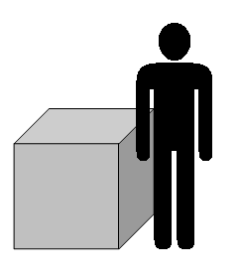
Advantages
Uses lesser amount of uranium compared with coal for the same energy output.
No CO₂ emissions
Yearly fuel of a nuclear power plant (NPP)
Notes:
Teaching Tip: Brainstorm advantages and disadvantages
Title:
Positives
Description of image:
Picture showing yearly fuel of NPP.
Ask:
Discuss:
Teacher notes:
Nuclear power stations, unlike coal, do not produce sulphur dioxide and carbon dioxide.
For more information:
http://www.uic.com.au/
Activity:

Slide 25
Disadvantages
Nuclear waste (can be poisonous for 1000’s of years)
Storage locations.
Possible use for nuclear weapons.
Notes:
Title:
Negatives
Description of image:
Ask:
Discuss:
Teacher notes:
Many people are concerned about the safety of nuclear power and what can be done with toxic waste.
On 26 April 1986, at 1:23:44, reactor no. 4 of the Chernobyl nuclear power station exploded. One hundred times more radiation was released than by the atom bombs dropped over Hiroshima and Nagasaki. © Chernobyl Interinform
For more information:
Go to the Uranium Information site at http://www.uic.com.au/
Activity:

Slide 26
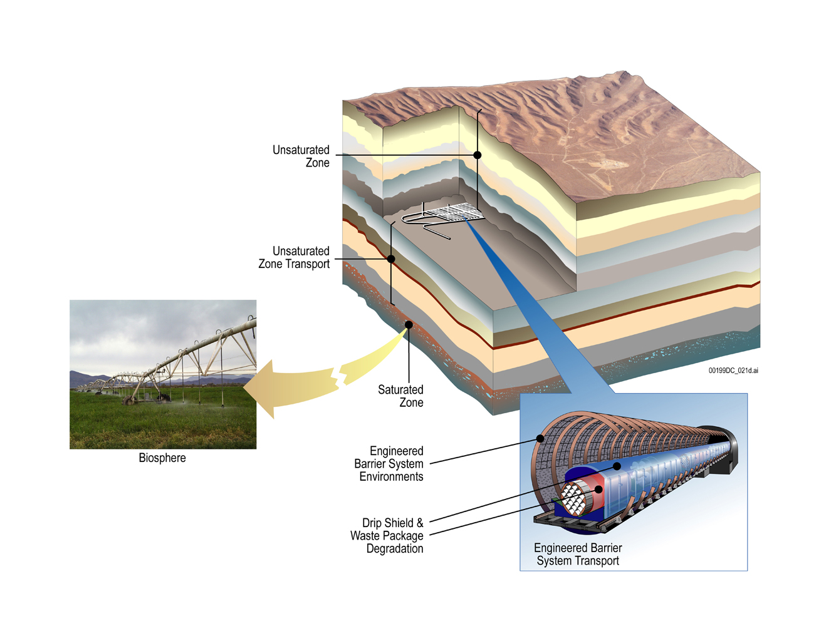
Nuclear Waste Disposal
Source: commons.wikimedia
Notes:
Image Description:
Cross section nuclear waste storageYucca Mountain
http://commons.wikimedia.org/wiki/Image:Yucca_Mountain_cross-section.jpg
Teaching Tip: Background Notes:
Cross-section showing a proposed way in which natural and man-made barriers would keep nuclear waste stored at the Yucca Mountain nuclear waste depository from leaking into the environment. "Natural and engineered barriers would work together to protect the environment.“
For more information:
Uranium Information site at http://www.uic.com.au/

Slide 27
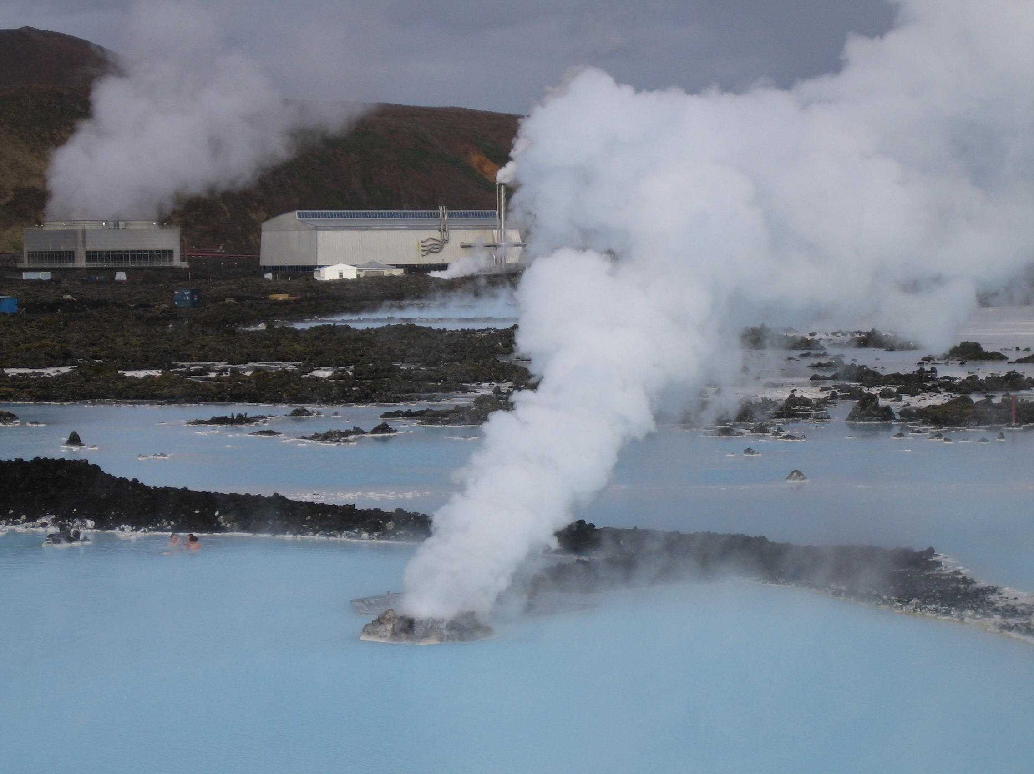
Geothermal
Energy that comes from the molten interior of the earth
Notes:
Image Description:
Geo thermal plant in Iceland.
Teaching Tip: Background notes:
Geothermal energy is heat energy that comes from the molten interior of the earth.
There are places where this molten material is close enough to the surface where it can
be harnessed. The heat energy is used to produce steam and as usual turns a turbine
to generate electricity.

Slide 28
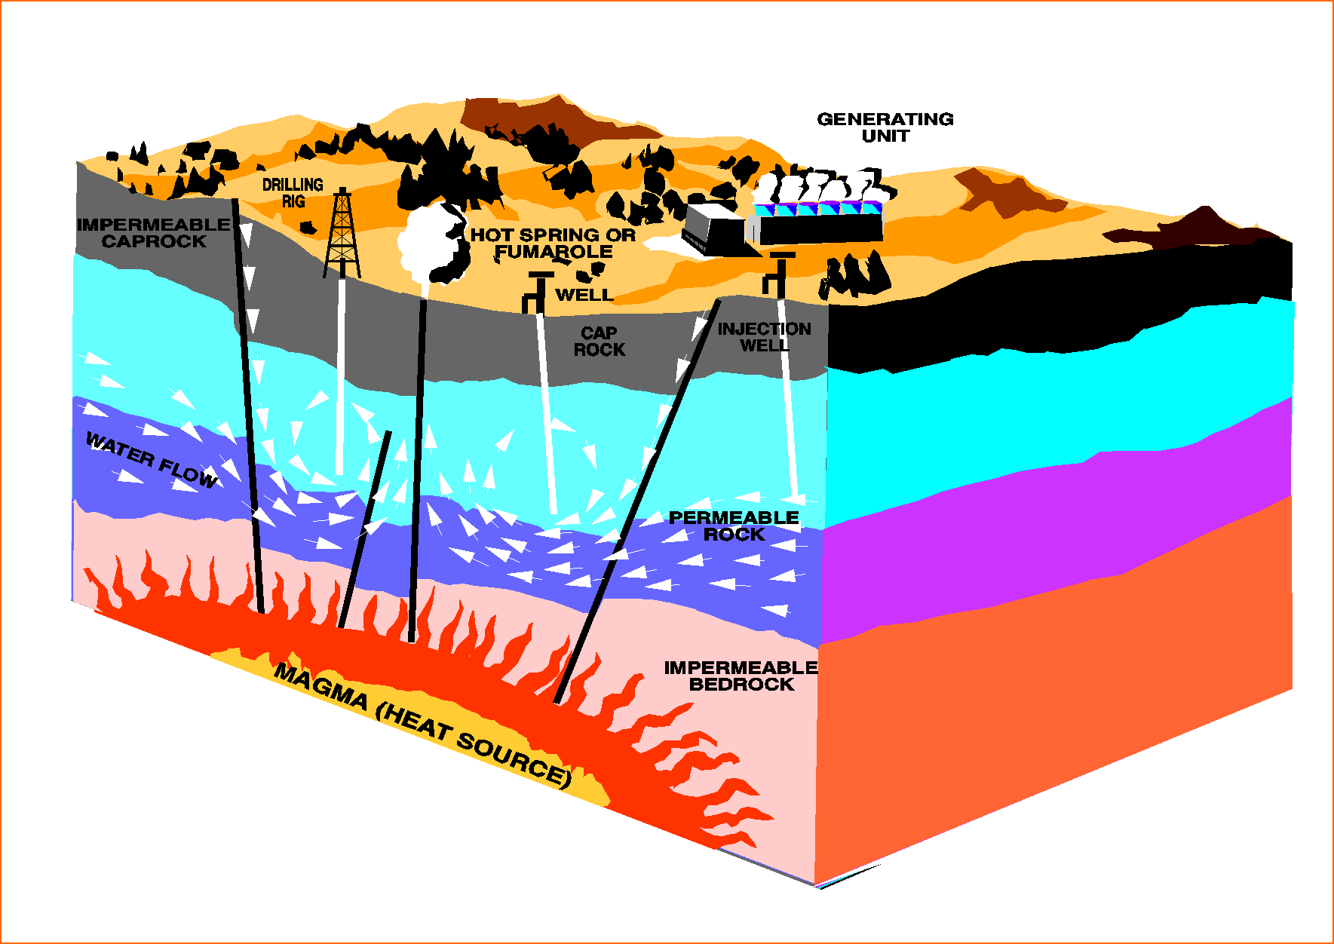
Geothermal
Heat source must be no more than 5-7 km below the earth’s surface
Must be at convergence of tectonic plates
Source: Commons.wikimedia
Notes:
Image Description:
Geothermal power technologies
http://commons.wikimedia.org/wiki/Image:Geothermal_energy_methods.png
Teaching Tip: Background notes:
Conditions for geothermal technology:
Heat source must be no more than 5-7 km below the earth’s surface
Must be at convergence of tectonic plates

Slide 29
Advantages
Advantages are:
Renewable
Less expensive energy source

Slide 30
Disadvantages
Disadvantages are:
Earth’s crust must be thin
Hot rocks and water must be close to earth’s surface.
Sometimes hot water pumped to the surface contains pollutants (sulphur)
Location restricted: Must be at convergence of tectonic plates.

Slide 31
Hot Dry Rocks
Hot Dry Rock Technology
Utilises advanced Australian mining/exploration technology
Suitable for Australian conditions
Notes:
Teaching Tip: Background Notes:
Hot dry rock geothermal energy (HDR) is a type of geothermal power production that uses the very high temperatures that can be found in rocks just a few kilometers below ground. This is done by pumping high pressure water down a borehole into the heat zone. The water travels through fractures in the rock, capturing the heat of the rock until it is forced out of a second borehole as very hot water, which is converted into electricity using a steam turbine. All of the water, now cooled off, is injected back into the ground to heat up again.
Hot dry rock is the end point for a range of technology for mining heat from the earth that consists of:
natural geothermal systems, where there are already cracks or pore spaces filled with water hot enough to generate power
systems where there are some cracks and connected pore spaces;
rocks where there are little to no cracks or connected pore spaces.
For more information:
For a fact sheet on geothermal energy go to http://www.dme.qld.gov.au

Slide 32
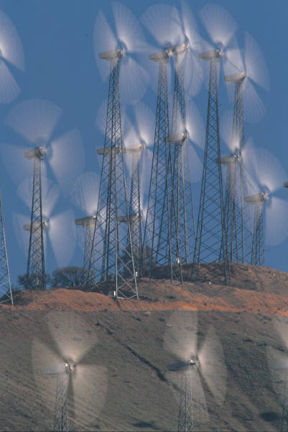
Wind
Renewable energy from the wind has been used for centuries to power windmills to mill wheat or pump water
Nowadays, large wind turbines are used to generate electricity.
Notes:
Image Description:
Wind farm
Teaching Tip: Background Notes:
Wind energy is the kinetic energy contained in the movement of a mass of air molecules.
The wind can be used to turn a turbine, which can then produce electricity using a generator.
Many wind turbines are relatively small, and large numbers are required to produce appreciable amounts of energy. Certain areas of the country are particular suitable for wind turbines.
The blades of these wind turbines are about 30 metres long. Wind turbines are collected together in wind farms.

Slide 33

Advantages
Advantages are:
Renewable
Energy source is free
No emissions except in the production of equipment.

Slide 34
Disadvantages
Disadvantages are:
Irregular wind speeds
Location needs to be in high wind area (coastal/mountainous)
Impacts on environment/habitat
Noise.

