Slide 1


MATHS IN MINING

Slide 2

Acknowledgements
Queensland Resources Council (QRC) would like to acknowledge Thiess Pty Ltd, and in particular Jack Pippenger, for the information contained in the following PowerPoint.

Slide 3
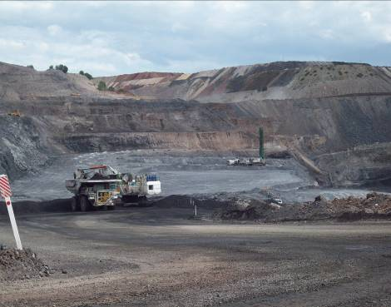
Overview
Mathematics is integral to the mining industry – used daily in many areas of the mining operation.
The next few slides detail just a few of the uses of Math in operating a successful mine.

Slide 4
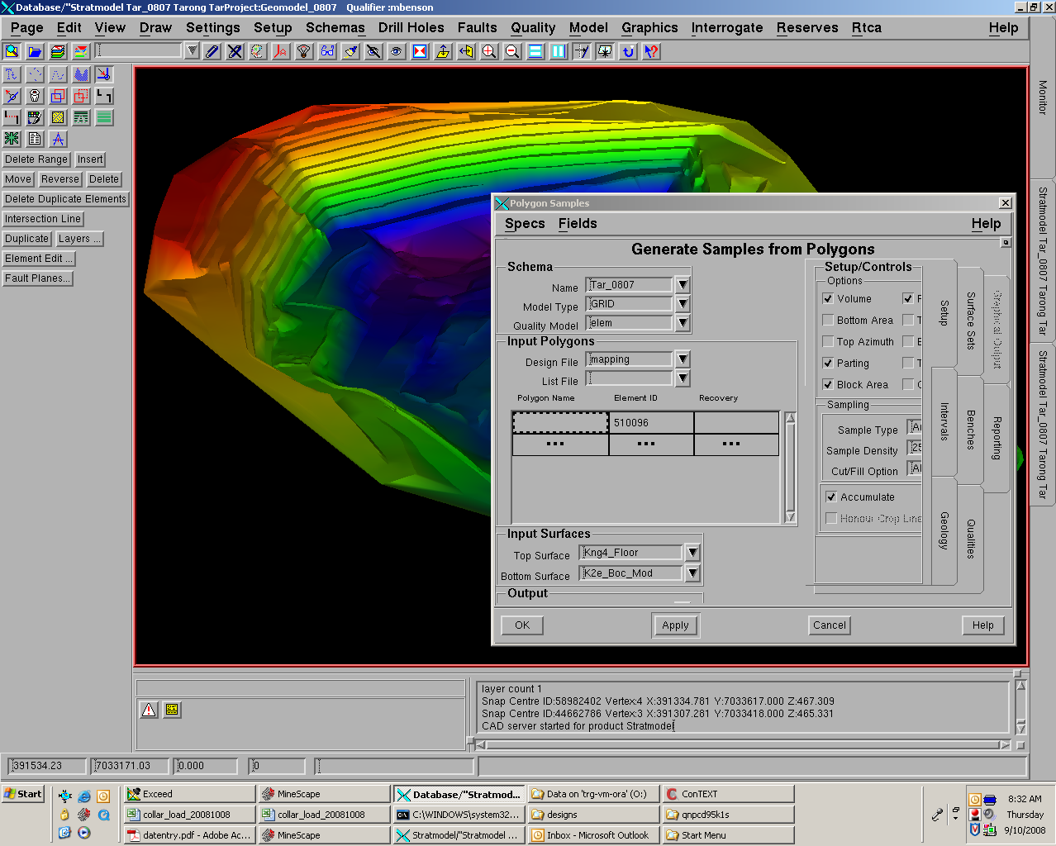
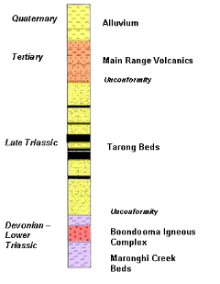
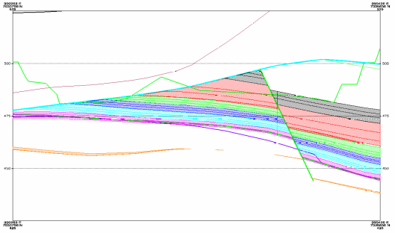
Geology
Math used constantly in Geology:
Exploratory drilling finds the coal.
Volumes calculated based on material thickness and average hole separation.
Coal reserves calculated using coal volumes and material density.
Quality and washability requires extensive math including calculus.
Math expressions (algebra) also used to
predict faults and other geologic strata.

Slide 5
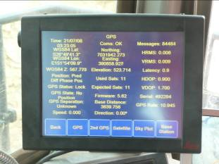
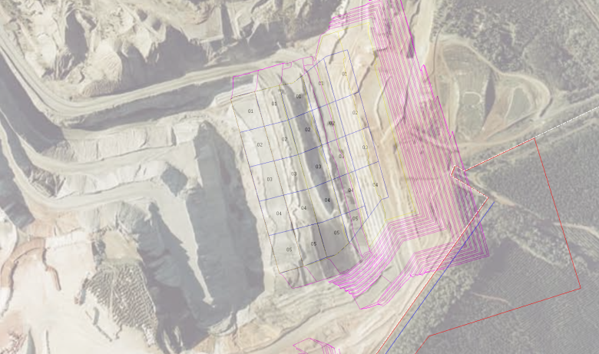
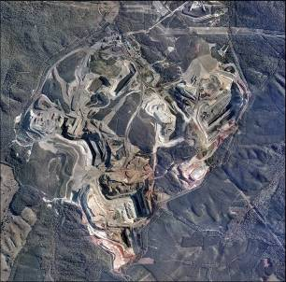
Surveying
Math used in surveying:
Establish mine boundaries
Mark drill holes
Construction design
Track actual work done.

Slide 6
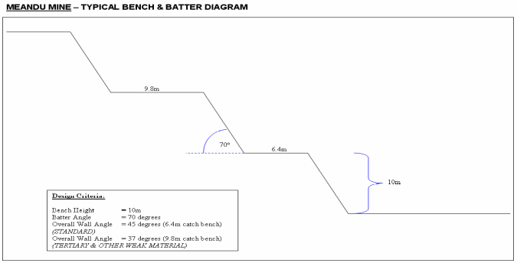
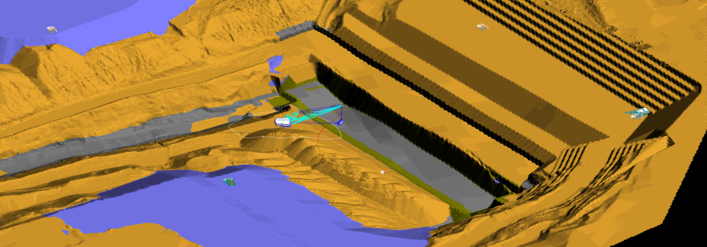
Pit Design
Math used in Pit Design to establish safe and cost effective operating conditions:
Highwall and lowwall angles based on material conditions (Requires Trig, Geometry and Calculus)
Actual mining volumes require Trig. and Algebra.
Trig. And Geometry also used for
detailed design work.
Completed Strip

Slide 7
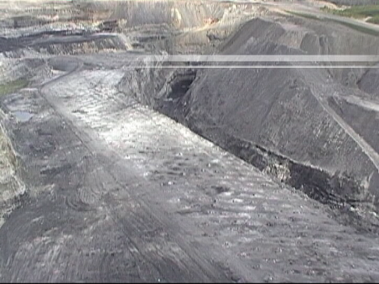
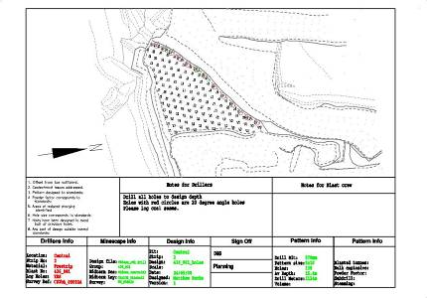
Drill and Blast
Math used in drill and blast design:
For calculating spacing between holes.
Volume of explosives in holes
Powder factors.

Slide 8
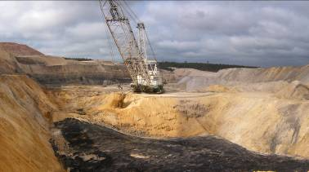
Equipment Scheduling
Activity | Unit | Quantity (‘000)
Truck/Excavator – Prime Waste | BCM | 11,157
Cast – Prime Waste | BCM | 794
Dozer – Prime Waste | BCM | 610
Dragline - Prime Waste | BCM | 7,072
Total – Prime Waste | BCM | 19,632
Dragline - Rehab Waste | BCM | 3,718
Dragline - Total Waste | BCM | 15,303
Blasting – Waste | BCM | 16,110
Blasting – Coal | BCM | 0
Drilled Metres | M | 217
Coal Mined | ROM t | 6,587
Coal Produced | PTE | 5,169
Math used in Equipment Scheduling:
Determine productivity
Volumes or Tonnes moved
Hours of operation required
Labour requirements
Cost of production.

Slide 9
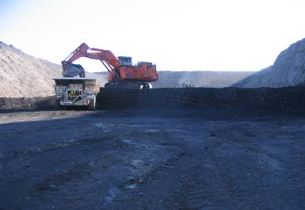
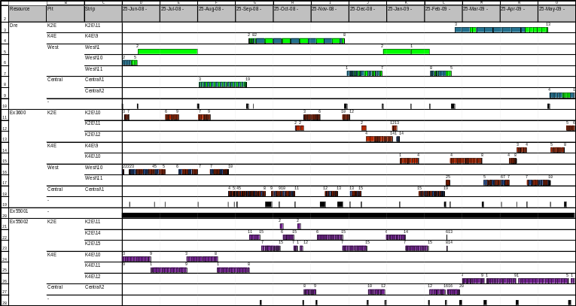
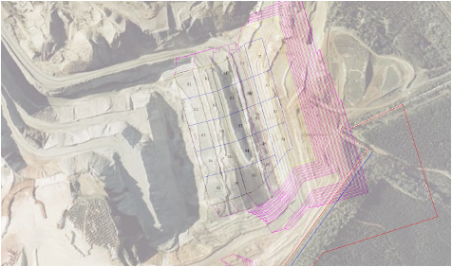
Role of Computers
Computers have provided significant improvements in use of Mathematics in mining:
Computerised modelling
Volume calculation
Equipment scheduling
Costing.

Slide 10
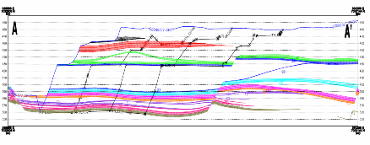

Role of Computers
Biggest assistance of computers is providing opportunities to study scenarios or options:
Changing equipment
Changing digging methods
Effects on costs and productivity
But never trust computers to do all the work or do it right!
Completed Strip

Slide 11
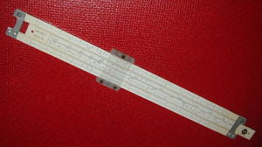

Summary
Mathematics is used daily in many ways to aid the mining industry.
All forms of math used from basic to Algebra, Geometry, Trigonometry and Calculus.
Mining would be in the dark without
mathematics.
Links:
www.nevadamining.org
www.lignite.com

