Slide 1


Low Emission Fossil Fuel Technologies

Slide 2
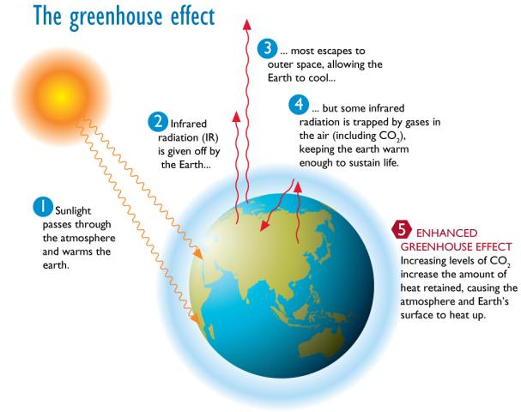
Greenhouse Effect
Image courtesy of CO2CRC: www.co2crc.com.au
Notes:
Image Description: Diagram of the Greenhouse Affect
Teaching Tip: Ask: Students to interpret diagram
Background Teacher notes:
Climate change is any substantial change in Earth’s climate that lasts for an extended period of time. Global warming refers to climate change that causes an increase in the average temperature of the lower atmosphere. Global warming can have many different causes, but it is most commonly associated with human interference, specifically the release of excessive amounts of greenhouse gases. (EPA, 2006)
Greenhouse gases, such as carbon dioxide (CO₂), methane (CH₄), water vapor, and fluorinated gases, act like a greenhouse around the earth. This means that they let the heat from the Sun into the atmosphere, but do not allow the heat to escape back into space. The more greenhouse gases there are, the larger the percentage of heat that is trapped inside the earth’s atmosphere. The earth could not exist in its present state (that is, with life) without the presence of some naturally occurring greenhouse gases, such as CO₂, CH₄, and water vapor. Without any greenhouse gases no heat would be trapped in atmosphere, so the earth would be extremely cold. (NASA, 2002) Source: http://web.mit.edu/12.000/www/m2010/finalwebsite/background/globalwarming/definition.html

Slide 3
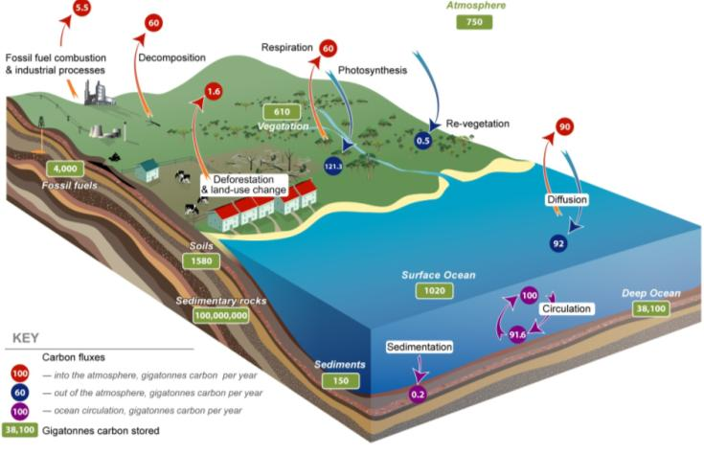
The Carbon Cycle
Image courtesy of CO2CRC: www.co2crc.com.au
Notes:
Image Description:
Teaching Tip: Ask: Students to interpret the diagram
Background Teacher notes:
The carbon cycle is usually thought of as four major reservoirs of carbon interconnected by pathways of exchange. These reservoirs are:
The plants
The terrestrial biosphere, which is usually defined to include fresh water systems and non-living organic material, such as soil carbon.
The oceans including dissolved inorganic carbon and living and non-living marine biota,
The sediments including fossil fuels.
The annual movements of carbon, the carbon exchanges between reservoirs, occur because of various chemical, physical, geological, and biological processes. The ocean contains the largest active pool of carbon near the surface of the Earth, but the deep ocean part of this pool does not rapidly exchange with the atmosphere.
The global carbon budget is the balance of the exchanges (incomes and losses) of carbon between the carbon reservoirs or between one specific loop (e.g., atmosphere ↔ biosphere) of the carbon cycle. An examination of the carbon budget of a pool or reservoir can provide information about whether the pool or reservoir is functioning as a source or sink for carbon dioxide. Source: http://en.wikipedia.org/wiki/Carbon_cycle

Slide 4
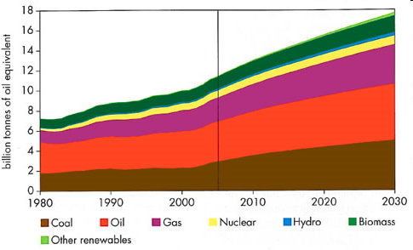
Why low emission fossil fuel technologies?
Energy requirements predicted to double by 2020
With large increases in energy requirements, renewable sources alone will not suffice.
World primary energy demand in the reference scenario. From International Energy Agency – World Energy Outlook 2007.

Slide 5
Carbon Capture and Storage (CCS)
Capture and storage of carbon dioxide that would otherwise be emitted in the atmosphere.
Capturing occurs at the point of emission.
Captured gases stored in underground reservoirs.
Porous rocks act as underground reservoirs.
Carbon capture
Notes:
Teacher Background Notes:
The capture of carbon dioxide (CO2) from a stationary source, such as a power plant, involves trapping, or capturing, the CO2 rather than allowing it to be released to the atmosphere.
The main sources potentially suitable for CO2 capture are industrial processes, electricity
generation and possibly in the future, hydrogen production.
Industrial processes that may lend themselves to CO2 capture now include natural-gas processing; ammonia production; and cement manufacture, but the total quantity of CO2 produced by these processes is limited.
A far larger source of CO2, accounting for approximately half of all CO2 emissions in Australia, is fossil-fuelled electricity generation, whether that be from coal, oil or
natural gas. While the basic building block technologies exist for capture from these sources, and such a plant could be built today, more research is required on these capture technologies to reduce the power cost increases to the community.
Following capture, CO2 is then injected deep underground into porous and permeable rocks within geological
reservoirs between one and three kilometres beneath the surface. (See next slide)
Source:CO2CRC http://www.co2crc.com.au/media/

Slide 6
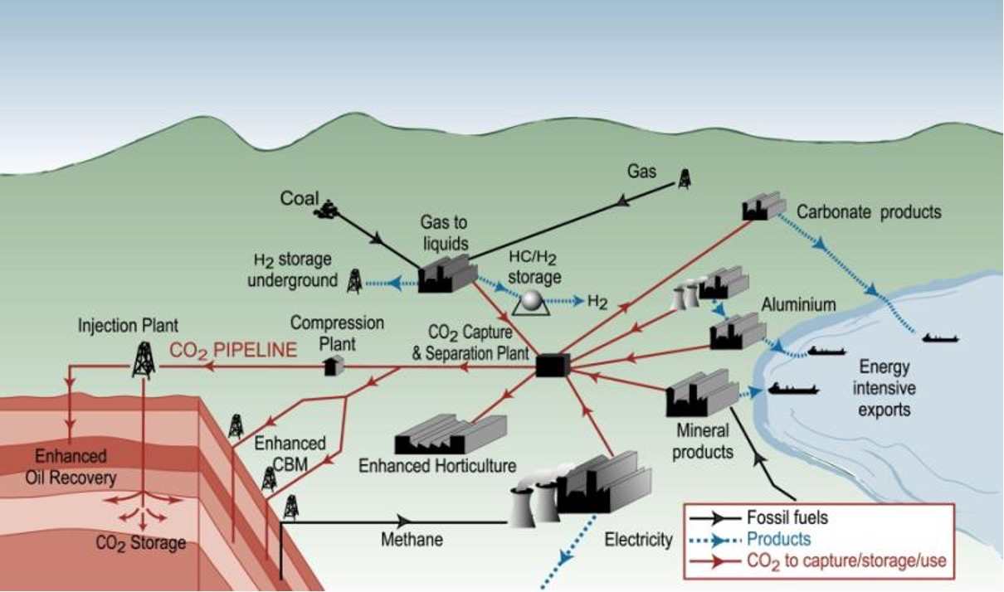
Sources of CO₂ Capture
Image courtesy of CO2CRC: www.co2crc.com.au
Notes:
Image Description: Flow diagram; sources for CO2 Capture
Background Teacher notes:
The capture of carbon dioxide (CO2) from a stationary source, such as a power plant, involves trapping, or capturing, the CO2 rather than allowing it to be released to the atmosphere.
The main sources potentially suitable for CO2 capture are industrial processes, electricity generation and possibly in the future, hydrogen production.
Industrial processes that may lend themselves to CO2 capture now include natural-gas processing; ammonia production; and cement manufacture. The larger source of CO2, is fossil-fuelled electricity generation, whether that be from coal, oil or natural gas. Research is ongoing into how these capture technologies can operate effectively and reduce the power cost increases to the community.
Source:CO2CRC http://www.co2crc.com.au/media/

Slide 7
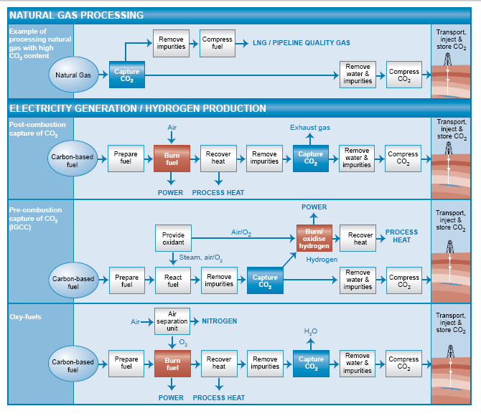
Methods of Carbon Capture-
Low Emission Fossil Fuel Technologies
Post-combustion capture of CO₂
Pre-combustion capture of CO₂
Oxyfuel Combustion
Geosequestration
Image courtesy of CO2CRC: www.co2crc.com.au
Notes:
Teacher background Notes:
Technologies for capturing CO2 from electricity generation fall into three categories: postcombustion, pre-combustion and oxy-firing.
In post-combustion capture CO2 is separated from the flue gas after fuel is burnt from
conventional power stations, either coal or natural gas.
During pre-combustion capture the fossil fuel is brought into contact with steam and oxygen, producing a synthetic gas (syngas), largely comprising carbon monoxide (CO), carbon dioxide and hydrogen (H2).
This syngas can then be combusted in power gas turbines to produce electricity – such plants exist today. The CO2 is removed from the syngas before combustion in the power gas turbines.
However, for maximum CO2 removal an additional reaction (water gas shift) is used to convert the residual carbon monoxide to CO2 and additional hydrogen with water.
This process can be applied to all fossil fuels, but in the case of coal, the solid fuel is gasified in either an oxygen or air-blown gasifier. Examples of this process are Integrated Gasification Combined Cycle (IGCC) or Integrated Drying Gasification Combined Cycle (IDGCC) – an Australian-developed technology.
Oxy-firing combustion capture is where fuel is combusted in pure oxygen. The process produces about 75 per cent less flue gas than air-fueled combustion and the exhaust consists of between 80 and 90 per cent CO2. The remaining gas is water vapour, which simplifies the CO2 separation
step. An air separation plant is required to produce pure oxygen for the process from air.
While the capture of CO2 for geosequestration is a relatively new concept, CO2 capture for
commercial markets has been practised in Australia and overseas for many years.
CO2 is captured from natural gas wells in South Australia, near Mt Gambier and in southern
Victoria, near Port Campbell. The CO2 is then used for various commercial processes including carbonation of beverages and dry-ice production. In the United States, CO2 capture at power plants using chemical absorption based on the monoethanolamine solvent has been practised since the late 1970s, with the captured CO2 being used for enhanced oil recovery as well as smaller scale CO2 beverage manufacture.
CO2 capture and geosequestration
Following capture, CO2 is usually transported from a source, such as a power station, to the geological storage site in a compressed form via a pipeline (though other forms of transportation such as road, rail or ship are feasible and may well be economic in certain situations).
Source:CO2CRC http://www.co2crc.com.au/media/

Slide 8
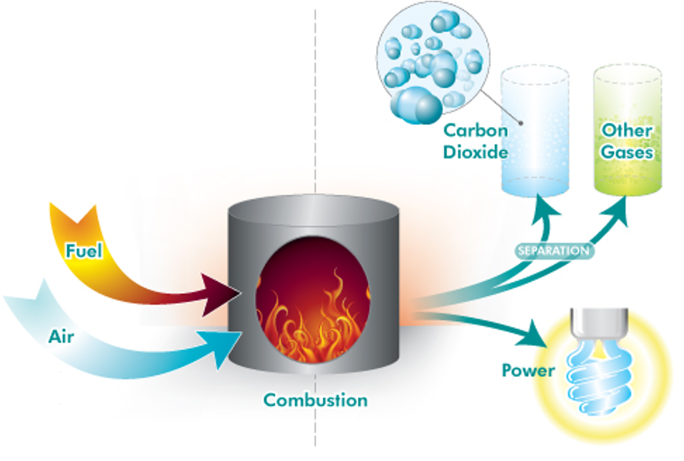
Post Combustion Capture
Image courtesy of CO2CRC: www.co2crc.com.au
Notes:
Image Description:
In post-combustion capture CO2 is separated from the flue gas after fuel is burnt from
conventional power stations, either coal or natural gas.
Teacher notes:
Capturing the carbon dioxide from a typical existing power plant is referred to as post-combustion capture, in which the low-pressure exhaust gases (currently emitted to the atmosphere) are passed through a separation process. Post-combustion facilities can be retrofitted to existing power plants or provided as a feature of new plants in the future, but there is a need to bring down costs considerably. Despite the existing cost barrier, post-combustion capture is receiving increased attention because many existing coal-fired power stations will continue to operate for 30 years or more
Source: www.co2crc.com.au

Slide 9
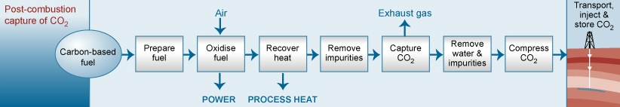
Advantages & Disadvantages
ADVANTAGES:
Can be retrofitted to existing plants
Renewable technologies can be integrated.
DISADVANTAGES:
Cost of technology – retrofitting
High running costs – absorber and degraded solvent replacement costs
Large amounts of energy required
Limited large scale operating experience.
Image courtesy of CO2CRC: www.co2crc.com.au

Slide 10
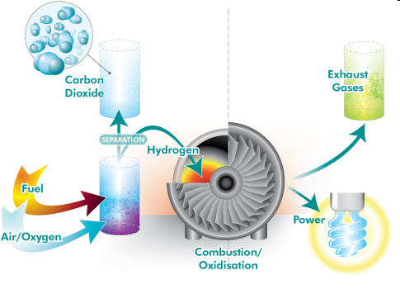
Pre-Combustion Capture
INTEGRATED GASIFICATION COMBINED CYCLE (IGCC)
Stage 1 - Coal gasification – partial oxidation of coal
coal + steam + limited oxygen = syngas (CO and H) (CO₂ and S removed).
Stage 2 – Creating Electricity
clean gas used to generate electricity in a conventional gas turbine (65%)
any hot exhaust gases are used to heat water to steam to produce electricity using a steam turbine (35%).
Image courtesy of CO2CRC: www.co2crc.com.au

Slide 11
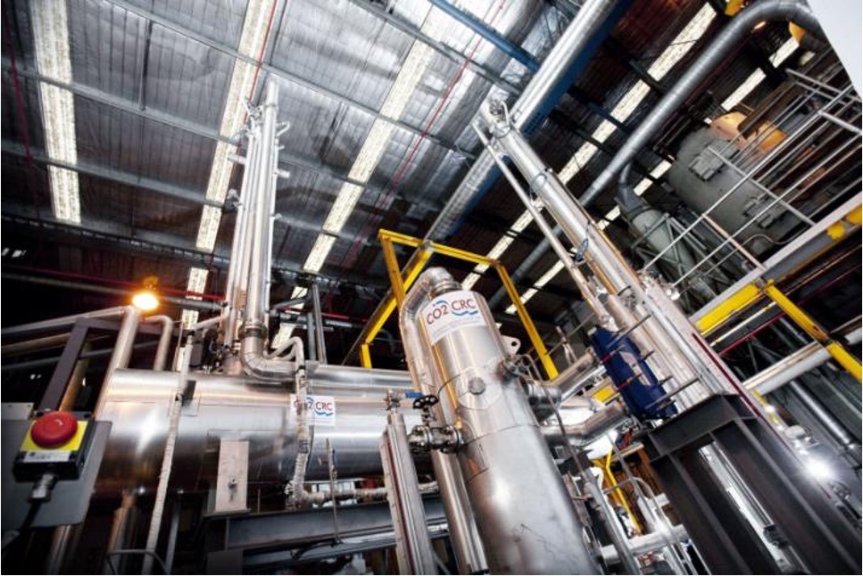
Pre-Combustion Capture Vic
Image courtesy of CO2CRC: www.co2crc.com.au
Notes:
Image Description:
The pre-combustion CO2 capture project will use this solvent rig to evaluate and improve solvent technologies for separating CO2 from syngas during the carbon capture process.
Teacher notes: Pre-combustion capture, involves Integrated Gasification Combined Cycle (IGCC). In this type of plant, the fuel is not burnt, but is reacted at high pressure and temperature with steam and oxygen to form a synthesis gas or syngas containing carbon monoxide, carbon dioxide, and hydrogen. This gas stream is then reacted further with water to convert the residual carbon monoxide to carbon dioxide and hydrogen, allowing the carbon dioxide to be captured and sent to storage. The hydrogen is burnt to produce power, leaving water vapour as the main exhaust to the atmosphere.
Source: www.co2crc.com.au

Slide 12
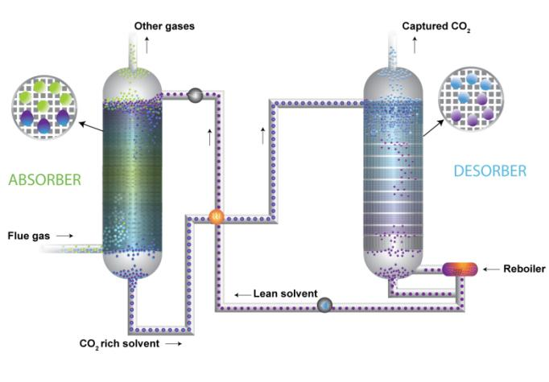
Solvent Based CO₂ Capture
Image courtesy of CO2CRC: www.co2crc.com.au
Notes:
Image Description: Flow Chart
Teacher notes: Solvent absorption is one method of carbon dioxide separation technology
Source: www.co2crc.com.au

Slide 13
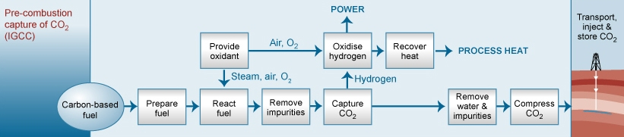
IGCC – Advantages & Disadvantages
ADVANTAGES
50% less solid waste
Uses 20 – 50% less water
Can utilise a variety of fuels - heavy oils, petroleum cokes and coals
95% CO₂ captured, 95% sulphur removed
Carbon capture less costly from IGCC than CPS
Syngas can be used in a variety of applications.
DISADVANTAGES
Requires a chemical plant
High investment cost.
Image courtesy of CO2CRC: www.co2crc.com.au

Slide 14
Oxyfuel Combustion
Oxygen produced by separation of air (nitrogen removed)
Coal is burnt in pure oxygen
Flue gas is free of nitrogen, and mostly consists of water vapour (removed) and carbon dioxide (separated and compressed to a liquid for later transport and storage).
Callide Oxyfuel Project

Slide 15
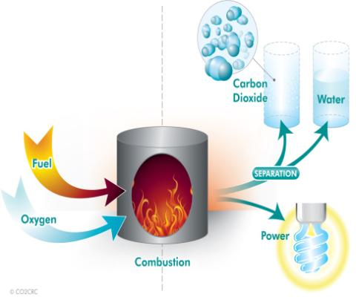
OxyFiring Combustion
Image courtesy of CO2CRC: www.co2crc.com.au
Notes:
Image Description: OxyFuel Combustion Process
Teacher notes: Oxyfiring combustion, sometimes called oxyfuel combustion is similar to that used in existing power plants, except that rather than burning the fuels in air, they are burnt in an artificially created oxygen atmosphere. Without the nitrogen which makes up about 78 per cent of the Earth’s atmosphere, this results in a flue gas with high carbon-dioxide concentrations (greater than 80 per cent by volume). The water vapour is then removed by cooling and compressing the gas stream. Changes are required to the boiler and associated flue-gas handling system to accommodate the higher flame temperatures resulting from combustion with oxygen
Callide Oxyfuel Project, Queensland
This demonstration project involves conversion of an existing 30MW unit at Callide A (currently underway) with power generation and capture of CO2 commencing in 2010. The second stage of the project will involve the injection and storage of about 60 000 tonnes of captured CO2 in saline aquifers or depleted oil/gas fields over about three years, planned to commence in 2011. Cost estimate is A$206 million.
Source: http://www.callideoxyfuel.com/

Slide 16
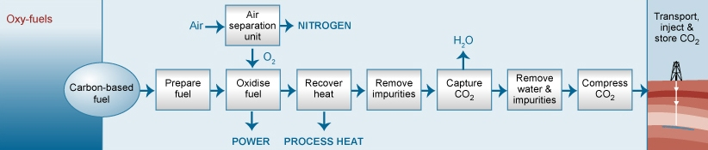
Advantages & Disadvantages
ADVANTAGES
Potentially 100% CO₂ capture
More complete combustion - few other harmful emissions
Possible to retrofit.
DISADVANTAGES
Requires large amounts of energy.
Image courtesy of CO2CRC: www.co2crc.com.au

Slide 17
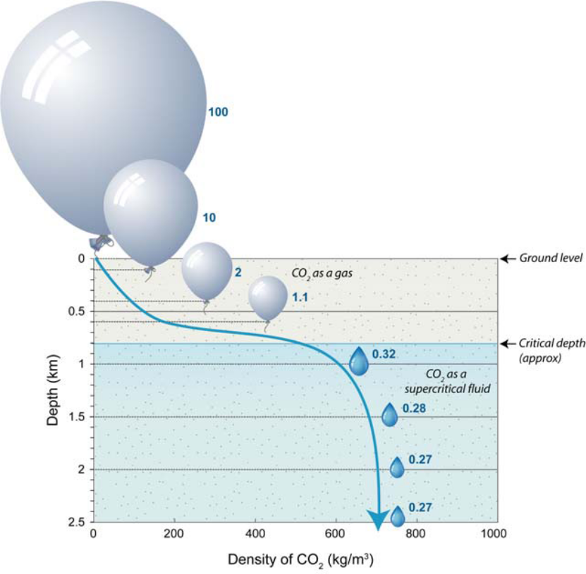
Geosequestration
Deep geological storage of carbon dioxide from major industrial sources.
Can be stored in:
  Depleted Oil and Gas Reservoirs
  Deep Saline Aquifers
  Unminable Coal Seams
Conditions for storage:
  Deep, high pressure
  Porous rocks capped by impermeable rock strata
Trapping Mechanisms
    Structural – rock strata keeps in place
    Solubility Trapping – dissolution of CO₂ into saline water
    Geosequestration
    Geochemical / Mineral – react with host rocks forming stable carbonate minerals.
Image courtesy of CO2CRC: www.co2crc.com.au
Notes:
Teacher Background Notes:
The fossil fuels, coal, oil and natural gas currently supply around 85 per cent of the world’s
energy needs.
The International Energy Agency predicts that fossil fuels will continue to be heavily used for many years to come.
The burning of fossil fuels is a major source of excess CO2, the most common greenhouse gas after water vapour, and the gas most likely to contribute to potential global warming.
The urgent need to reduce the atmospheric concentrations of CO2 requires a portfolio of
solutions including energy efficiency; using less carbon-intensive fuels; enhancing natural
carbon sinks (vegetation); and harnessing renewable energy from the wind, sun and tides.
Geosequestration is the deep geological storage of carbon dioxide from major industrial sources such as: fossil fuel-fired power stations, oil and natural gas processing, cement manufacture, iron and steel manufacture and the petrochemical industry.
(Source: CO2CRC http://www.co2crc.com.au/media/)

Slide 18
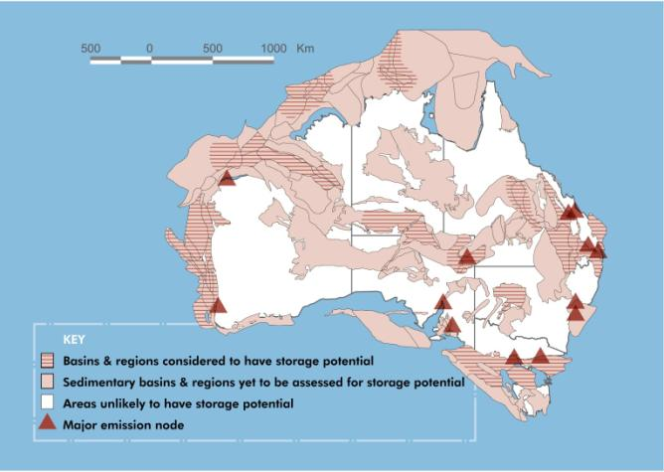
Potential CO₂ storage sites
Image courtesy of CO2CRC: www.co2crc.com.au
Notes:
Image Description: Map of potential C02 storage sites
Background Teacher notes:
An Australia-wide study of sedimentary basins conducted by CO2CRC and previously the Australian Petroleum CRC over the past 10 years has assessed 100 sites for the suitability for the safe, long-term storage of CO2.
The majority of these sites were found to be potentially suitable. Ideally, these areas have rocks such as permeable sandstone that are overlain by a seal of non-permeable rocks. Geosequestration sites must have simple geology. This means they should have no active faults and must have permeable and porous rock, such as sandstone, to absorb the CO2. The sandstone must be overlain by a mudstone or caprock that will trap the CO2 in the deep subsurface. (See fact sheet: What is Geosequestration, for further information ) http://www.co2crc.com.au/aboutgeo/capture.html
CO2CRC is undertaking a more detailed look at these and other sites to determine the most suitable areas for geosequestration.
Studies include:
Storage assessment of the Gunnedah Basin, NSW;
Storage assessment of the Sydney Basin, NSW;
A regional geology study of the Galilee Basin, Qld; and
the Otway Basin in Victoria, which is the site of Australia’s first geosequestration project,
the CO2CRC Otway Project. (See fact sheet: CO2CRC Otway Project for further
information. http://www.co2crc.com.au/aboutgeo/capture.html

Slide 19
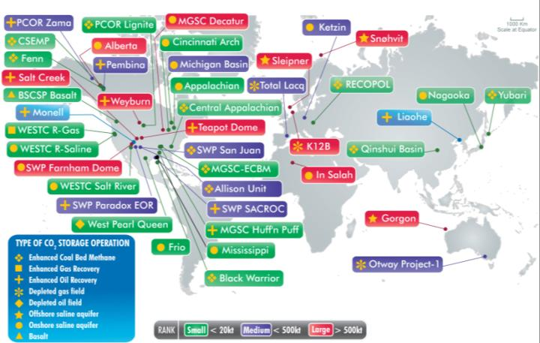
Active Projects Carbon Capture and Storage
There are currently four commercial installations each storing 1 million tonnes of CO2 per year.
Sleipner (1996), Weyburn (2000), In Salah (2004), Snohvit (2008)
Image courtesy of CO2CRC: www.co2crc.com.au
Notes:
Teaching Tip: Activity: Students to investigate one international site
Today we have four commercial installations each storing about 1 million tonnes (106 tonnes or 1 megatonne) of CO2 per year. The first of these, Sleipner, started in
1996, followed by Weyburn (2000), In Salah (2004), and Snohvit (2008).

Slide 20
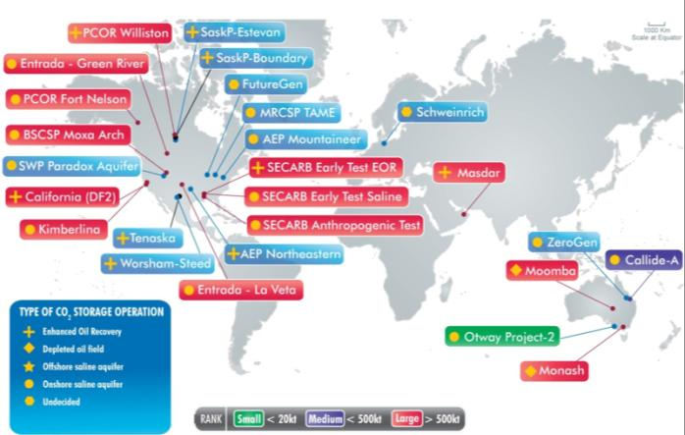
Proposed Projects Carbon Capture and Storage
Image courtesy of CO2CRC: www.co2crc.com.au
Notes:
Teaching Tip: Activity: Students to investigate one site for proposed CCS activity

Slide 21
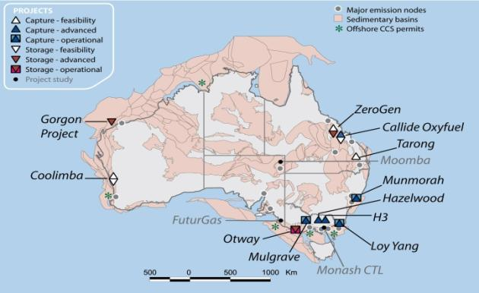
Aust Carbon Capture and Storage Projects
Image courtesy of CO2CRC: www.co2crc.com.au
Notes:
Background Teacher notes:
The Callide Oxyfuel Project will demonstrate carbon capture using oxyfuel combustion combined with carbon storage.
The Oxyfuel boiler is scheduled to be operational in the Callide A power plant by 2011. The plant, which has been out of service since 2001, is currently undergoing a complete overhaul.
The project team is assessing potential carbon storage sites to the west of the power plant and plans to select the final location in 2009. The carbon dioxide will be transported in road tankers.
Munmorah Power Station.
CSIRO’s Energy Transformed Flagship is working with Delta Electricity to test post-combustion capture at a pilot plant they have built at the Munmorah Power Station.
The Flagship’s goal is to provide proof of the post-combustion concept, evaluation of various CO₂ absorbents, assistance in the scale up to demonstration and commercial plants, and provide the science underpinnings for future policy options for CO₂ capture.
It is hoped the Munmorah project will provide the foundation for a $150 million post-combustion capture and storage demonstration project in NSW, planned for operation by 2013, capturing up to 100,000 tonnes of CO₂ each year.
ZeroGen
Through a staged deployment program, the project will first develop a demonstration-scale 120 megawatt (gross) IGCC power plant with CCS.
The facility is due to begin operations in late 2012 and will capture up to 75% of carbon dioxide (CO₂). Some of the CO₂ will be transported by road tankers for partial sequestration in deep underground reservoirs in the Northern Denison Trough, approximately 220km west of the plant.
To facilitate more rapid uptake of the technology at commercial scale, ZeroGen will concurrently develop a large-scale 450 megawatt (gross) IGCC power plant with CCS. Due for deployment in 2017, the facility will be one of the first of its kind in the world and will capture up to 90% of CO₂. Its location will be at a site in Queensland to be determined by a feasibility study.
ZeroGen Pty Ltd is currently supported by the Queensland Government and the coal industry’s COAL21 Fund
Source: http://www.newgencoal.com.au/solutions_ccs-projects_callide-oxyfuel.aspx

Slide 22
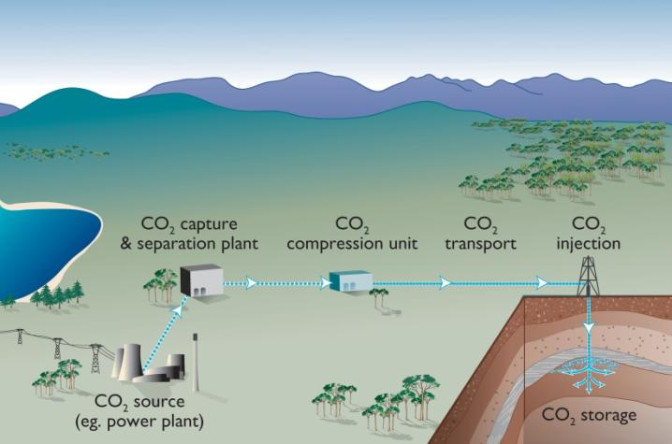
CO₂ CRC Project
Image courtesy of CO2CRC: www.co2crc.com.au
Notes:
Title: CO2 CRC Project
Description of image: A simplified overview of the geosequestration process
Ask: Students to interpret flow chart
Teacher notes: Geosequestration represents perhaps the only option for decreasing greenhouse gas emissions
while using fossil fuels and retaining our existing energy-distribution infrastructure.
Geosequestration is the deep geological storage of carbon dioxide from major industrial sources such as: fossil fuel-fired power stations, oil and natural gas processing, cement manufacture, iron and steel manufacture and the petrochemical industry.
The CO2CRC research effort focuses on developing efficient, economic and safe methods of
capturing carbon dioxide and geologically storing or geosequestering it in the deep subsurface
The CO2CRC Otway project is Australia’s most advanced storage demonstration project and the first demonstration of the deep geological storage or geosequestration of carbon dioxide. The project is of global significance. It involves leading Australian and international researchers working as part of CO2CRC to develop and implement a monitoring and verification that demonstrates geosequestration technology.
Injection of CO2 from a nearby gas well initially into a depleted gas field at a depth of 2km began in April 2008 at a rate of about 150 tpd, with an injection target of between 50,000 and 100,000 tonnes of CO2 over two years. A major program of monitoring and verification has been put in place. The A$40 million Project, involves researchers from Australia, New Zealand, Canada, Korea and the USA. Source: www.co2crc.com.au

Slide 23
Useful Websites
OresomeResources
www.oresomeresources.com
New Gen Coal – Australian Coal Association
www.newgencoal.com.au
Callide Oxy-firing
http://www.csenergy.com.au/
Australian Academy of Technological Sciences and Engineering http://www.atse.org.au/index.php?sectionid=1124
CCS and Otway Project
  http://www.CO2CRC.com.au

Slide 24
Queensland Resources Council wishes to acknowledge CO₂CRC for the supply of these images
www.co2crc.com.au
For more PowerPoints and other educational resources on minerals and energy visit www.oresomeresources.com

